Slide 1
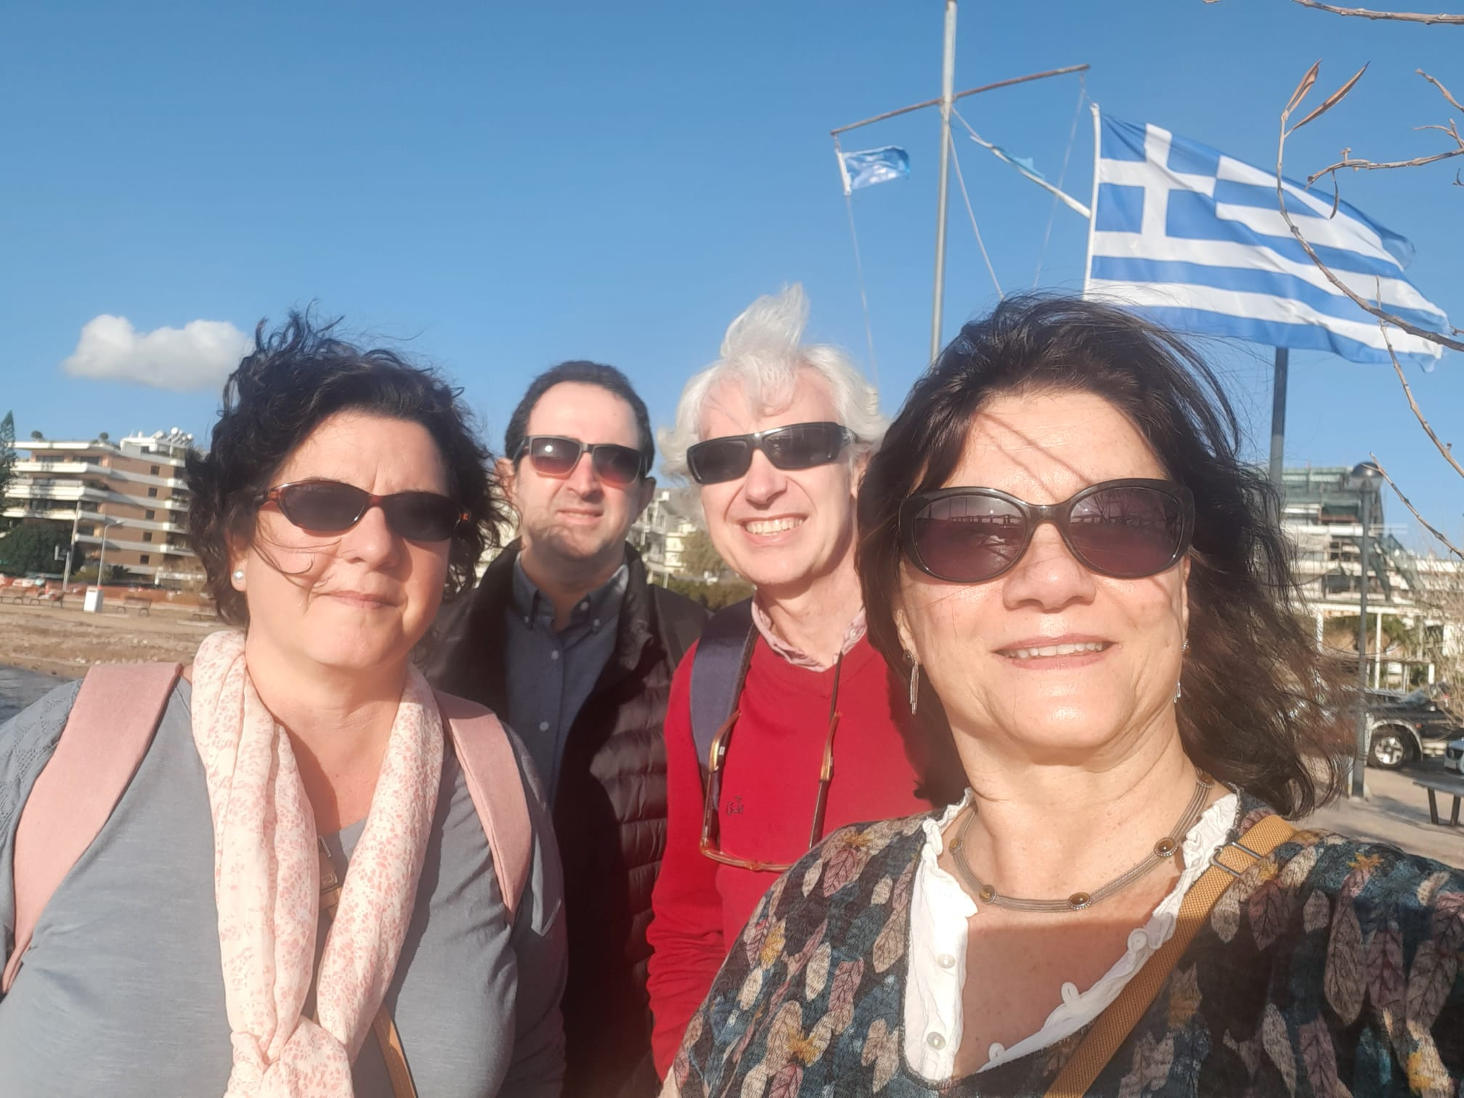
KA 226:We Are Ready for Digital World, A Greece
23-27 Jan 2023
Carmen Fdez Nevado• 2023 January 23-27

Slide 2
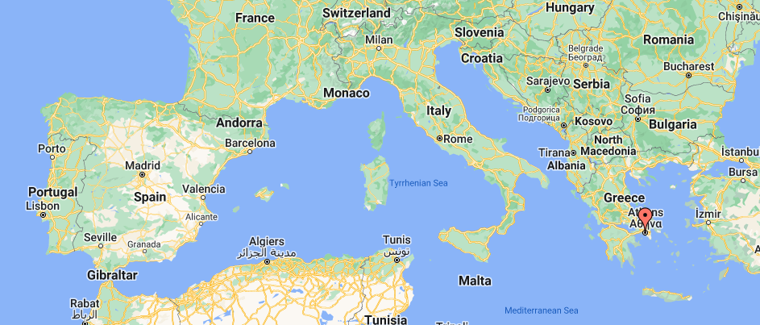
Map of Greece

Slide 3
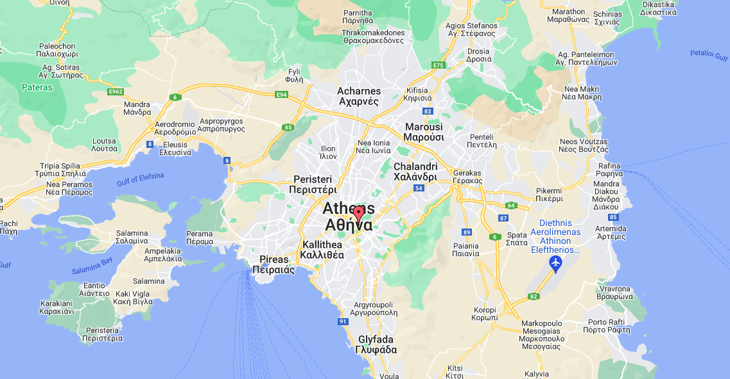
Map of Athens and Glyfada

Slide 4
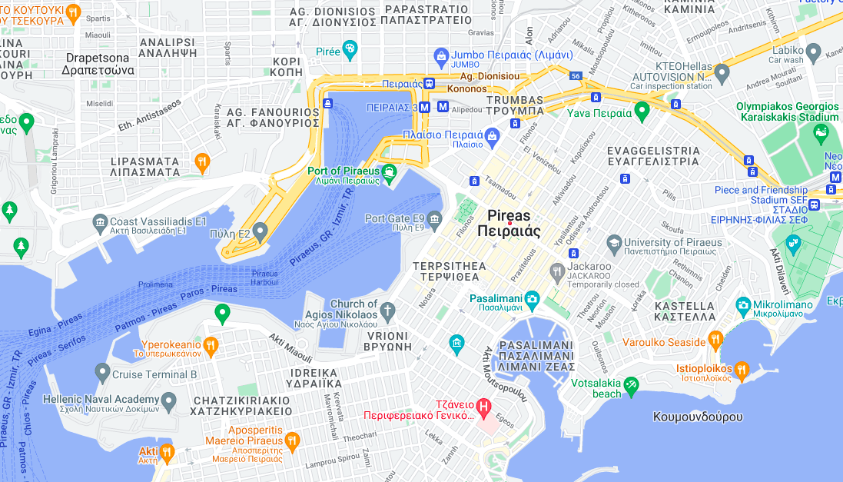
Map of Port of Piraeus and Pasalimani

Slide 5
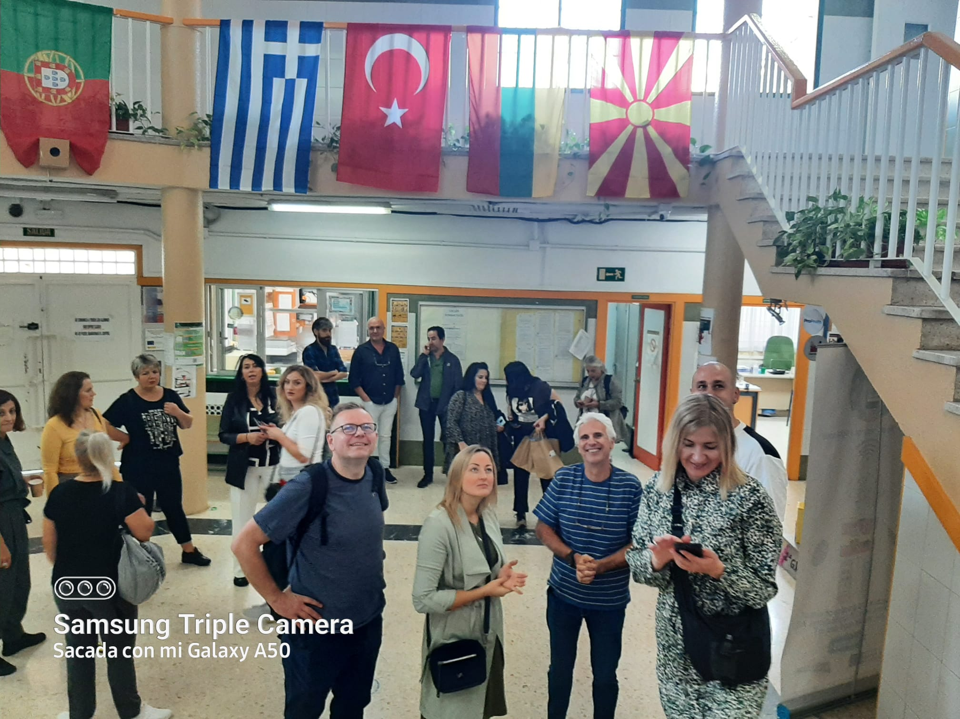
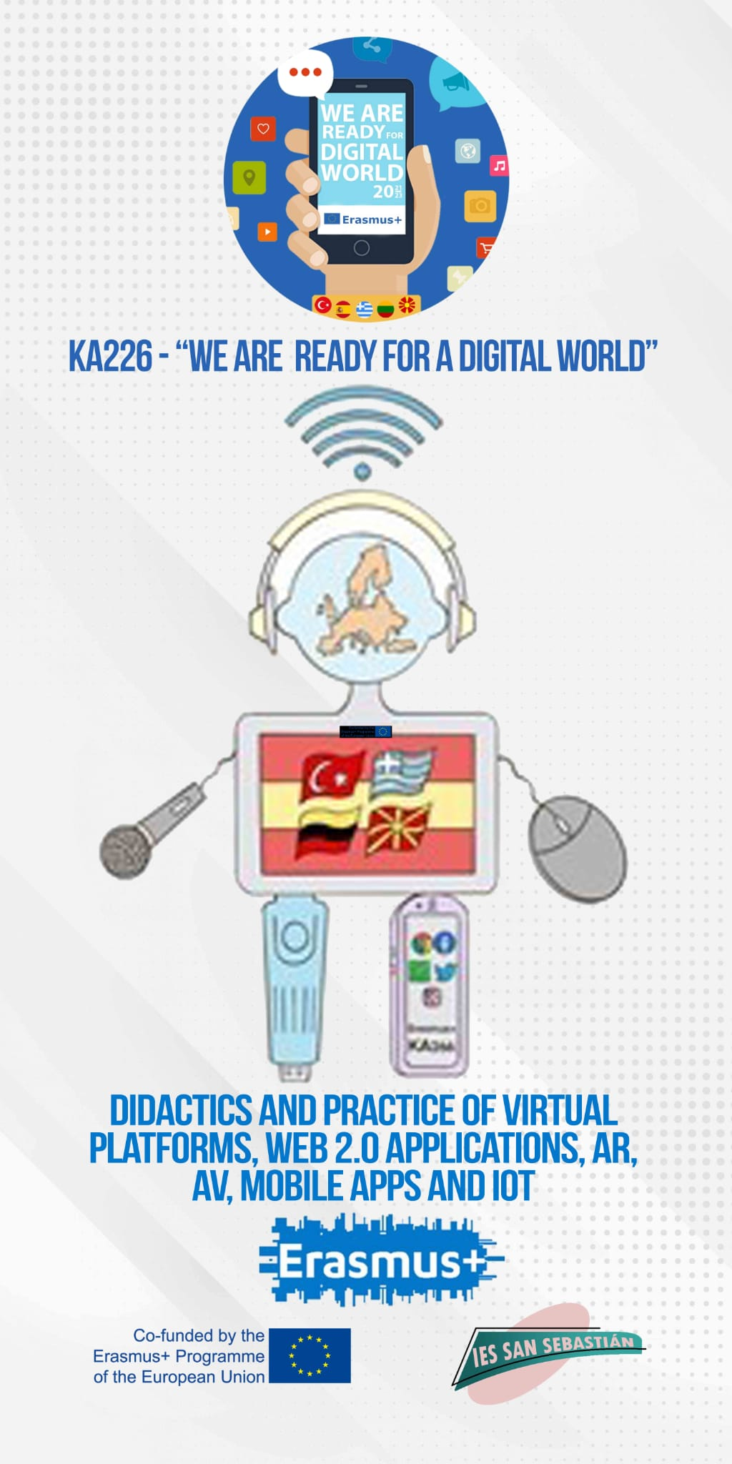
We Are Ready for Digital World is a project on New Technologies applied to the teaching and learning process and aiming at quality education.
It is particularly focused on apps and platforms used during Covid-19 lockdowns, when attending classes was not possible.
Spain, Greece, Turkey, Lithuania and North Macedonia are the participating countries.

Slide 6
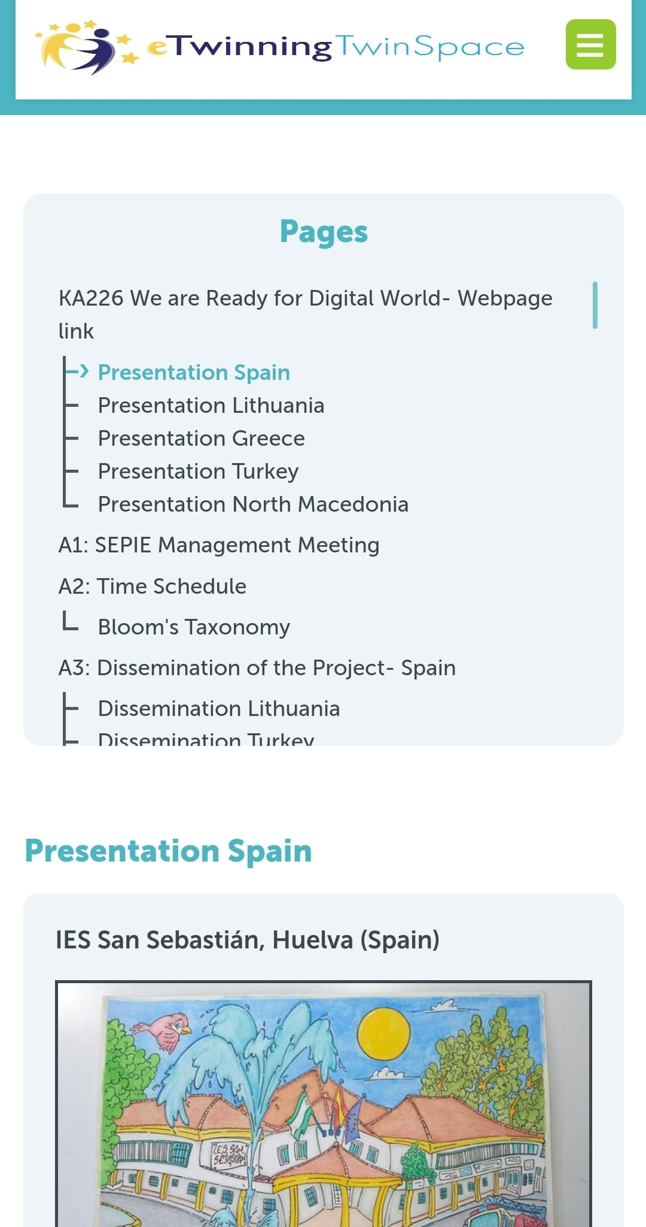
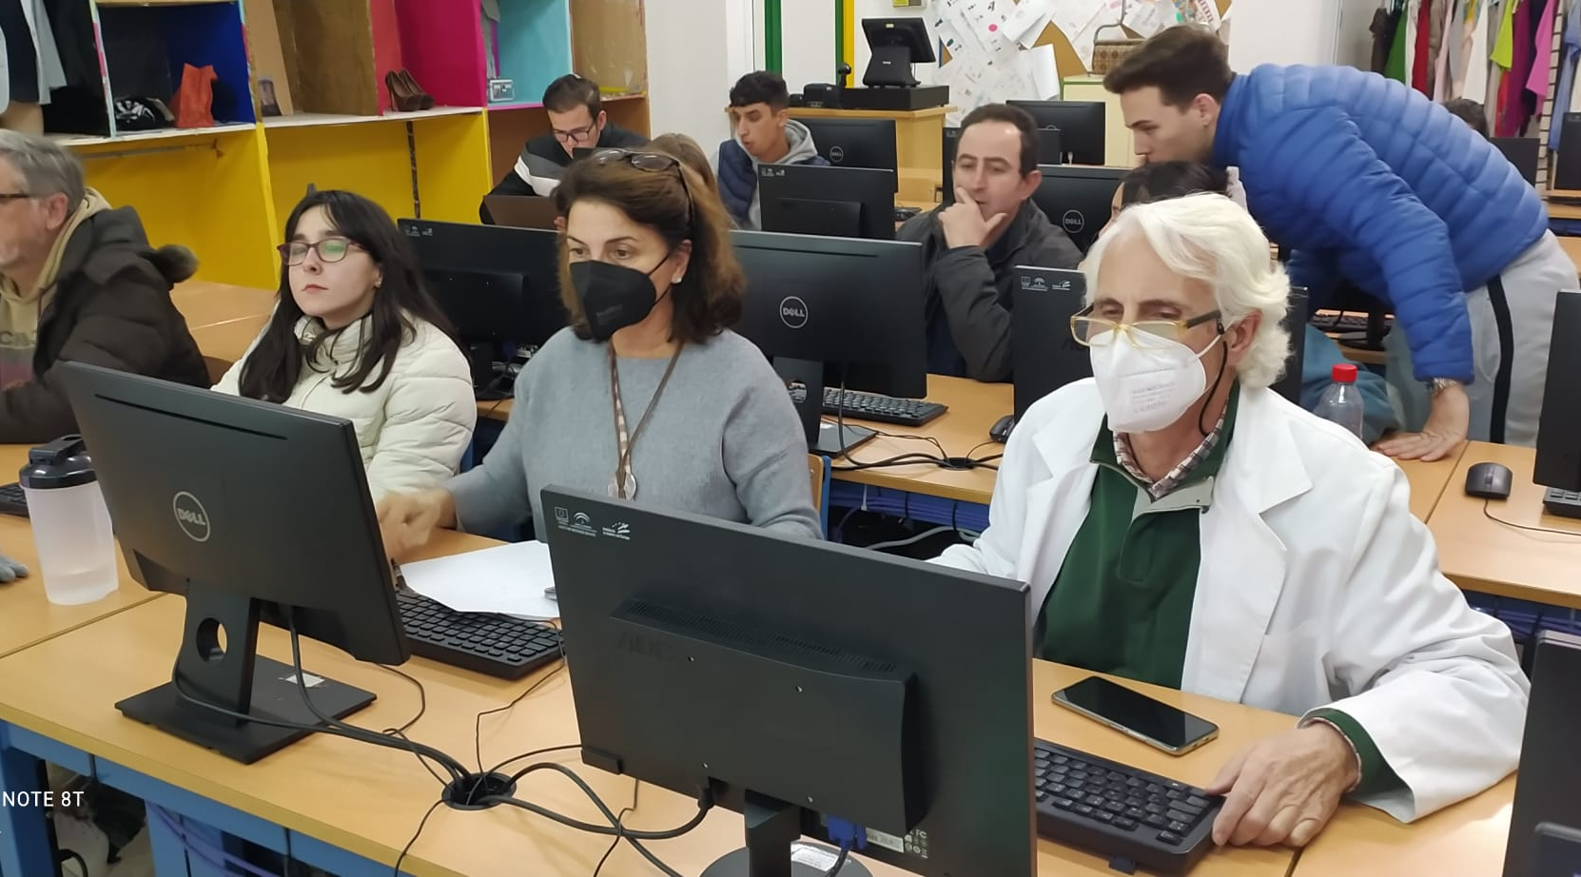
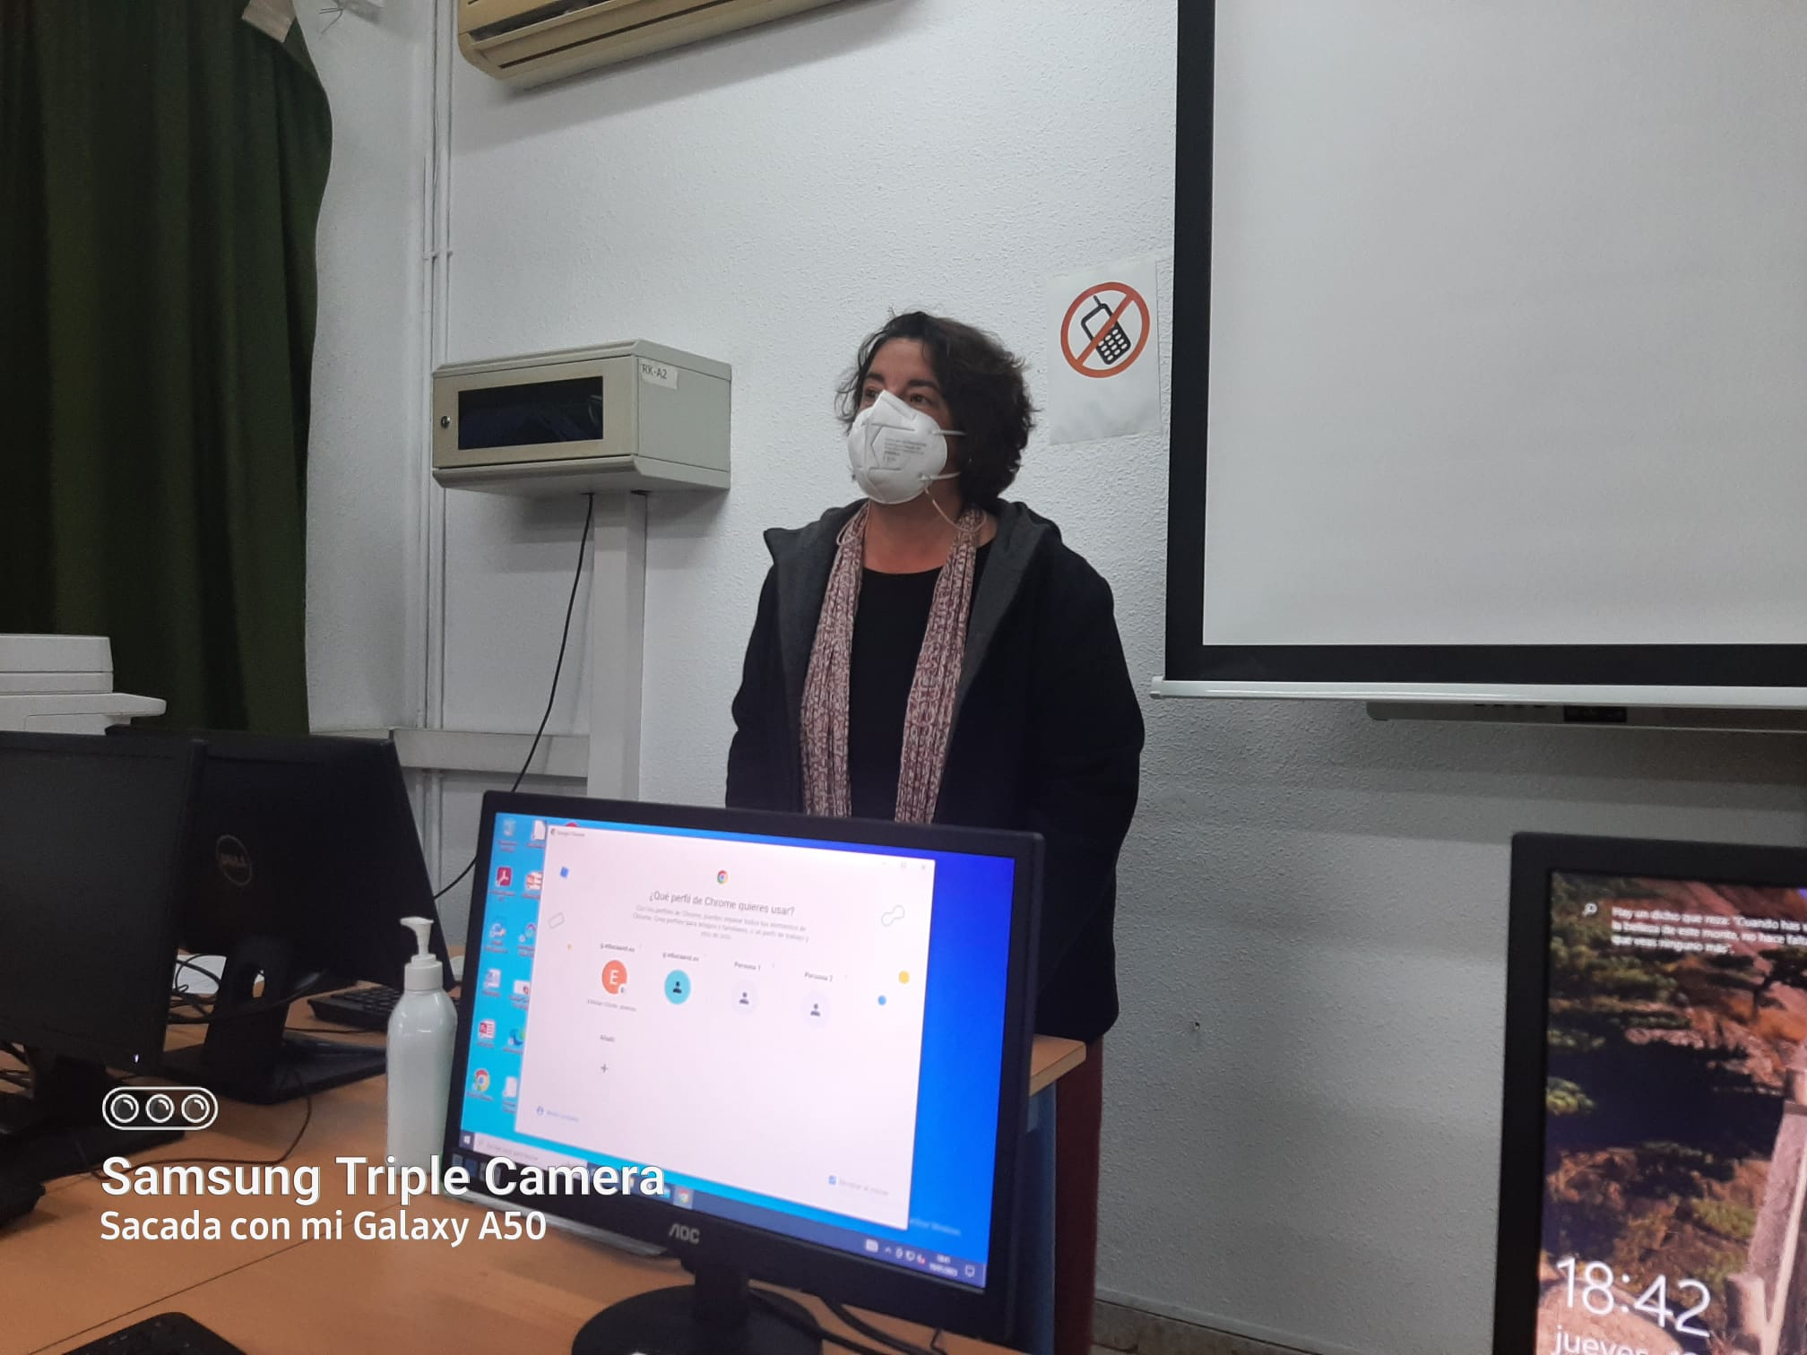
Teachers’ session on WordPress for our web page, organised by students at Commerce & Marketing
Previous work before the mobility:
we decided that WordPress was a
more versatile site than Wix to
disseminate the project as displayed
on eTwinning.

Slide 7
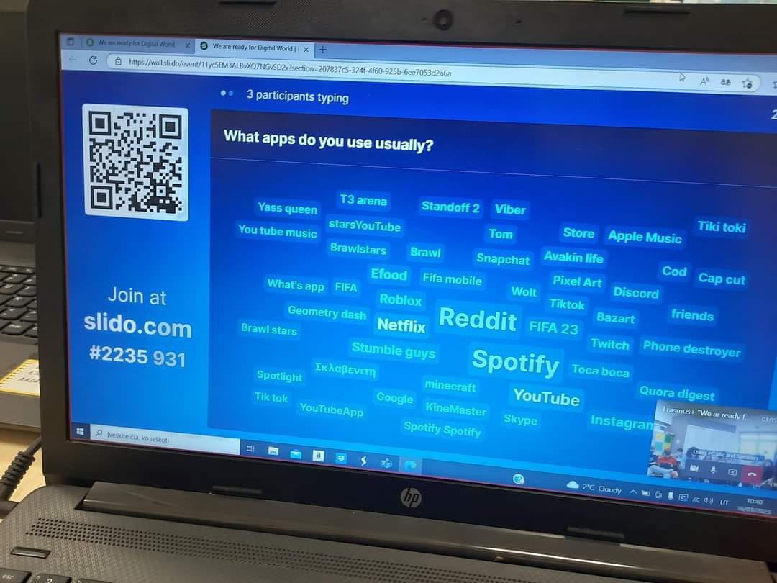
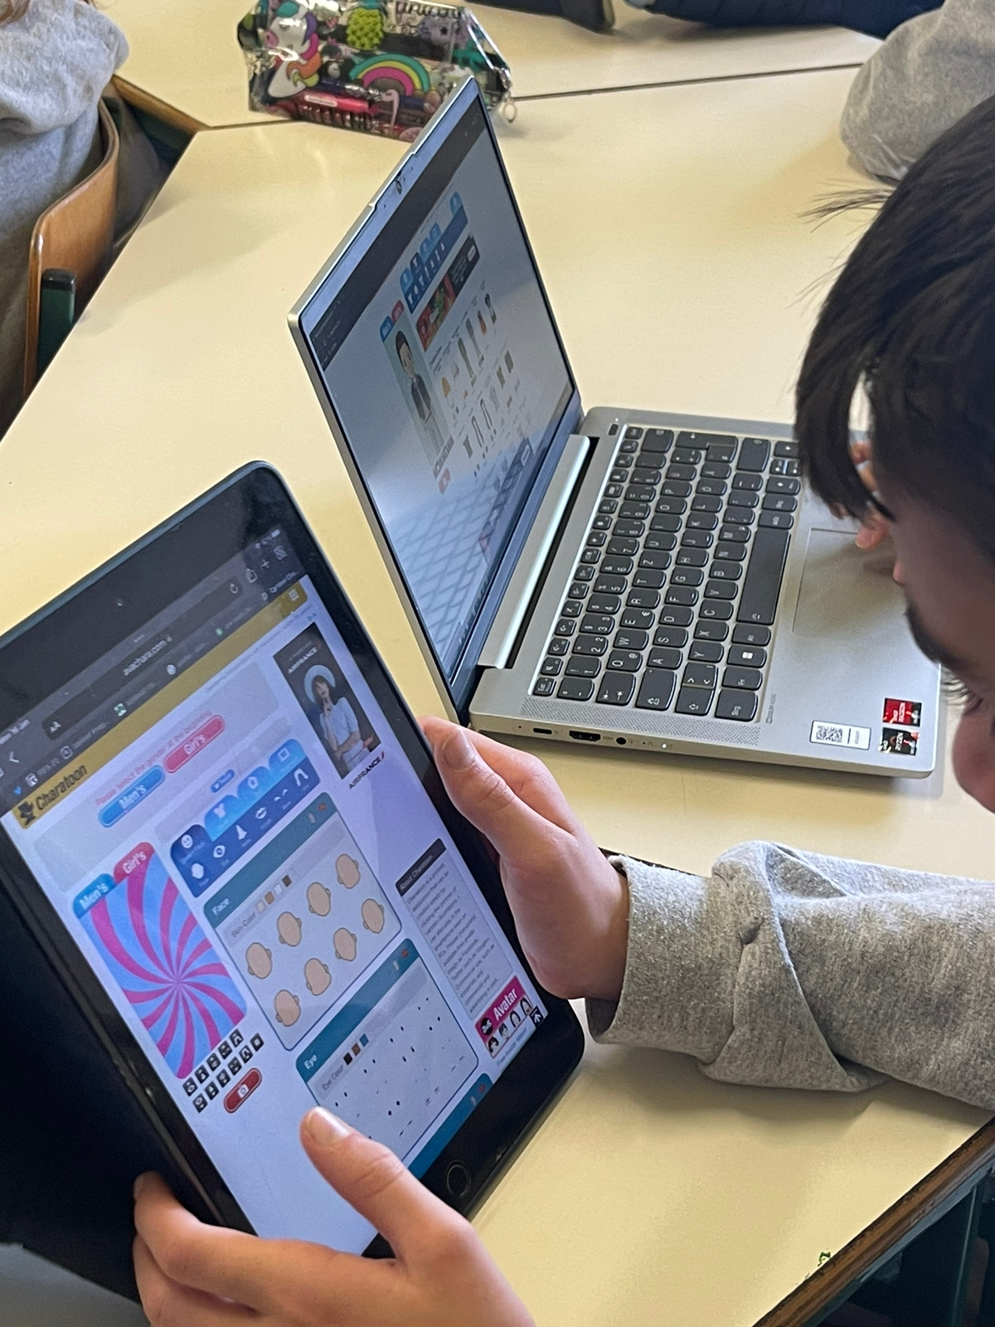
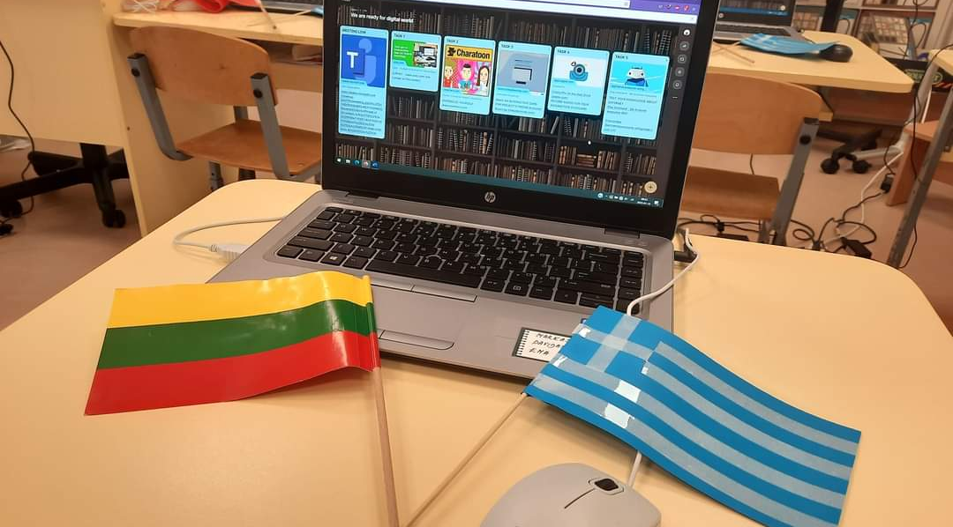
Virtual meeting between grade 4 students at Primary schools in Greece (Xenia) and Lithuania (Dainora,Lina).
Students created their avatars, interactive postcards, used Padlet, a game on cybersecurity and analysed the time spent in front of screens. Cooperation was the nicest objective.

Slide 8
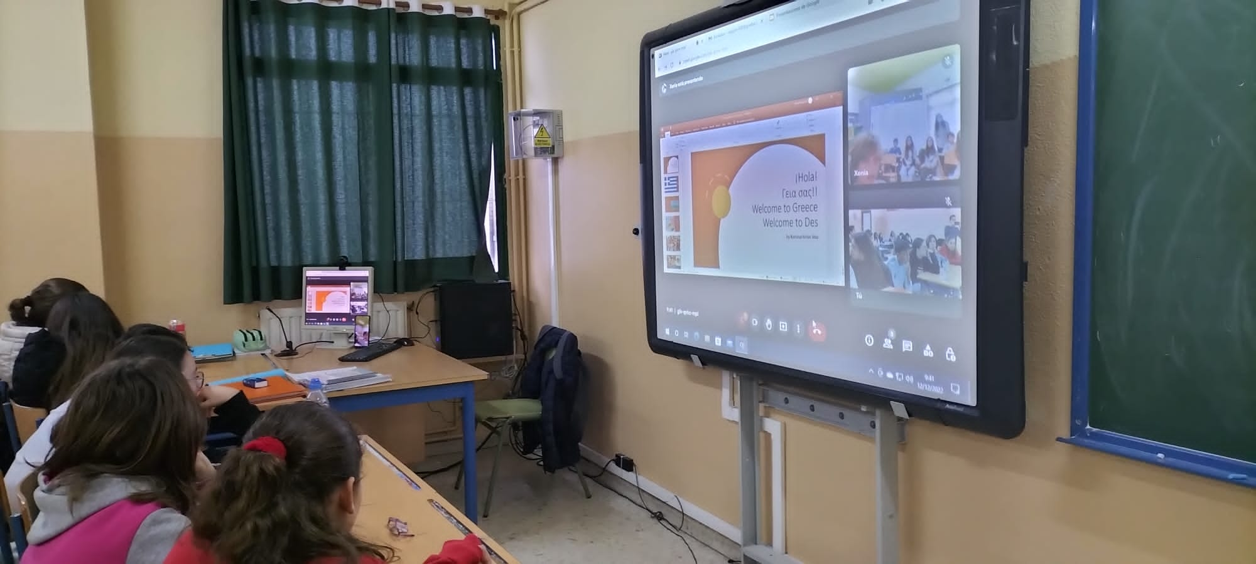
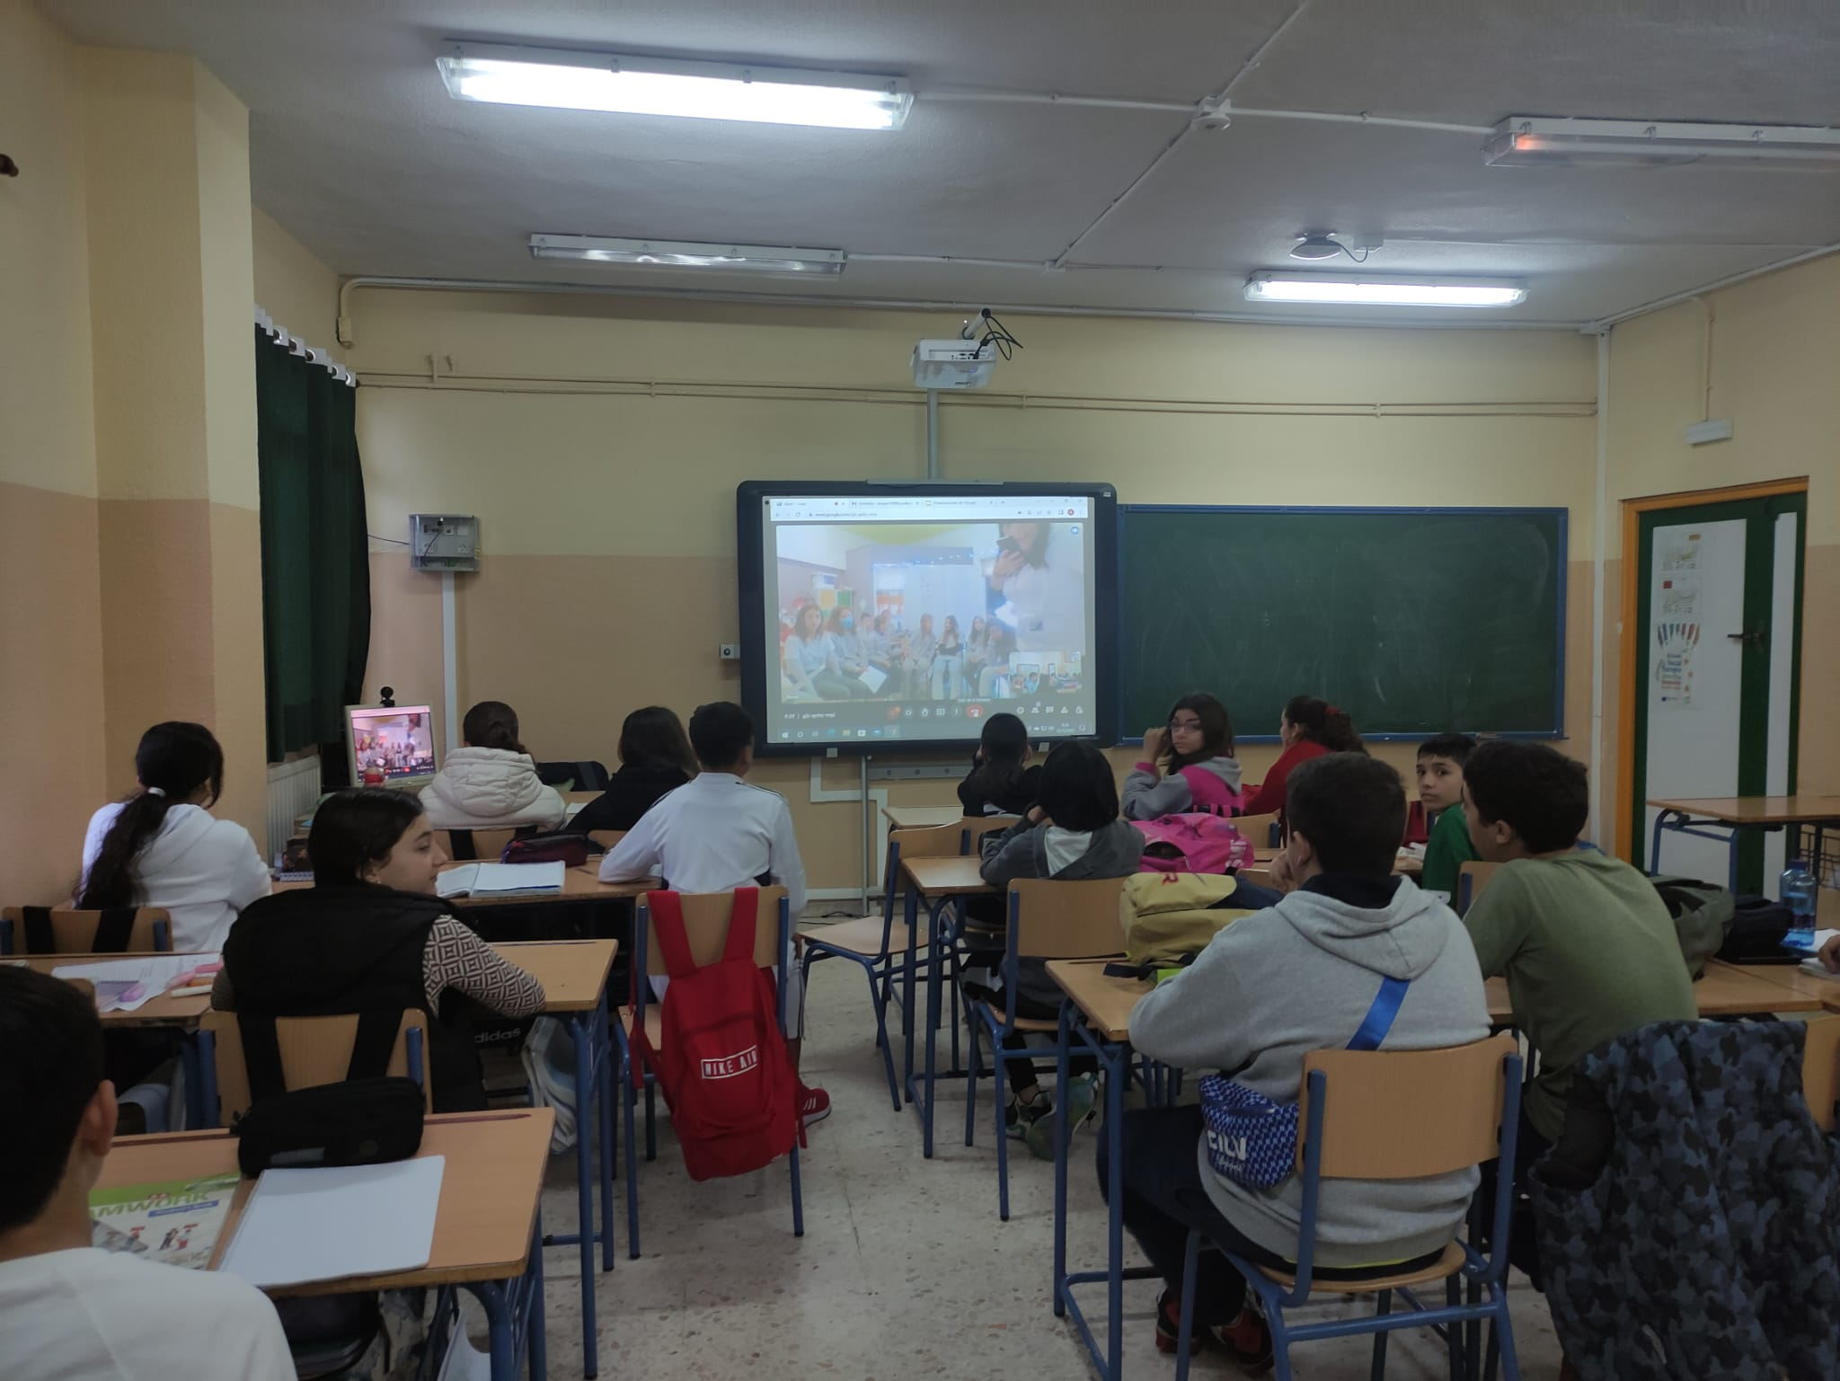
Virtual meeting between a 6th year Primary group in Greece (Xenia) and a 1st year Secondary group in Spain (Antonio López).
They talked about their countries, culture, traditions, …

Slide 9
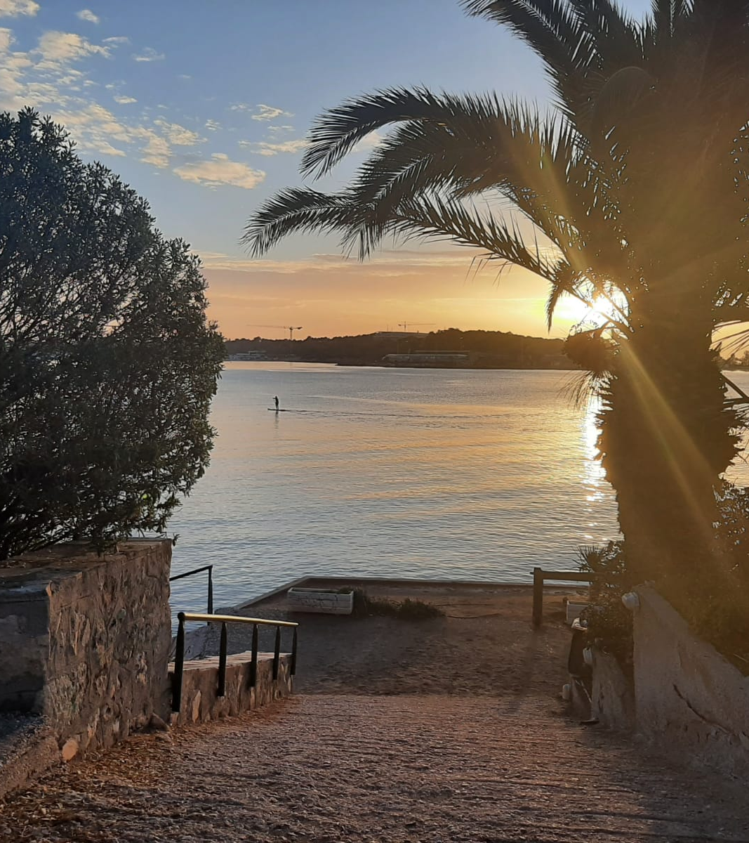
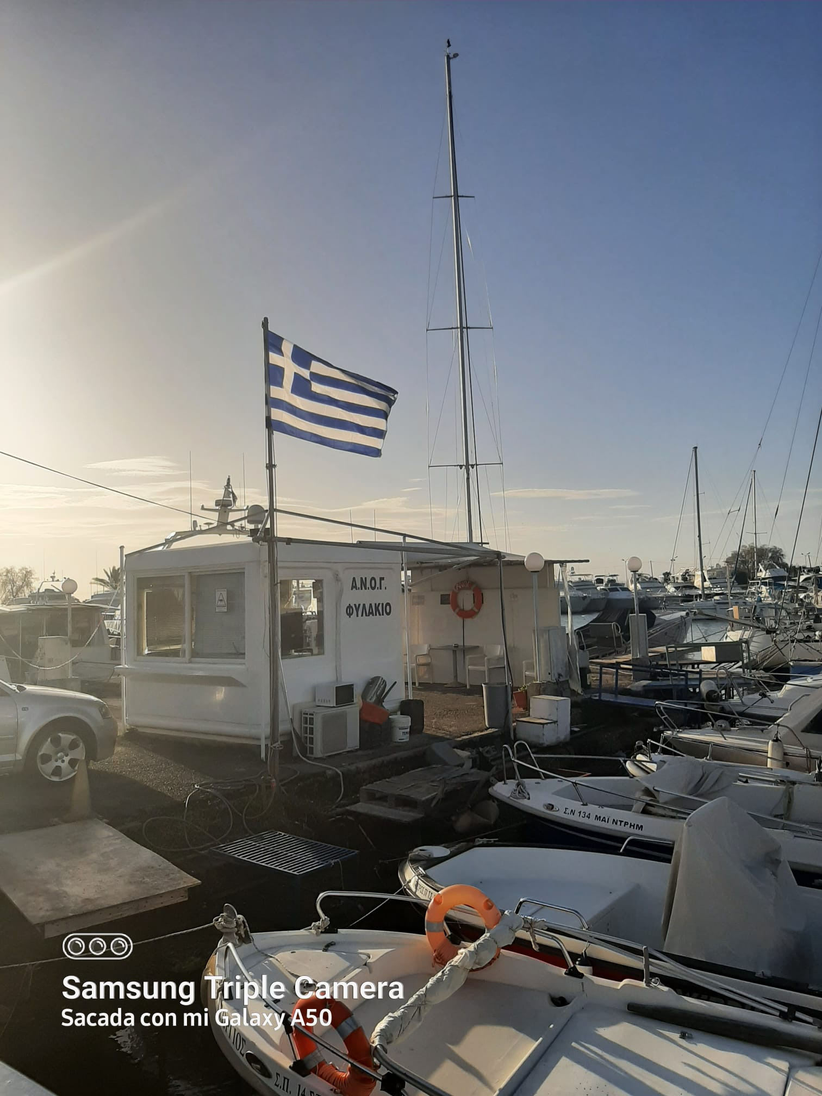
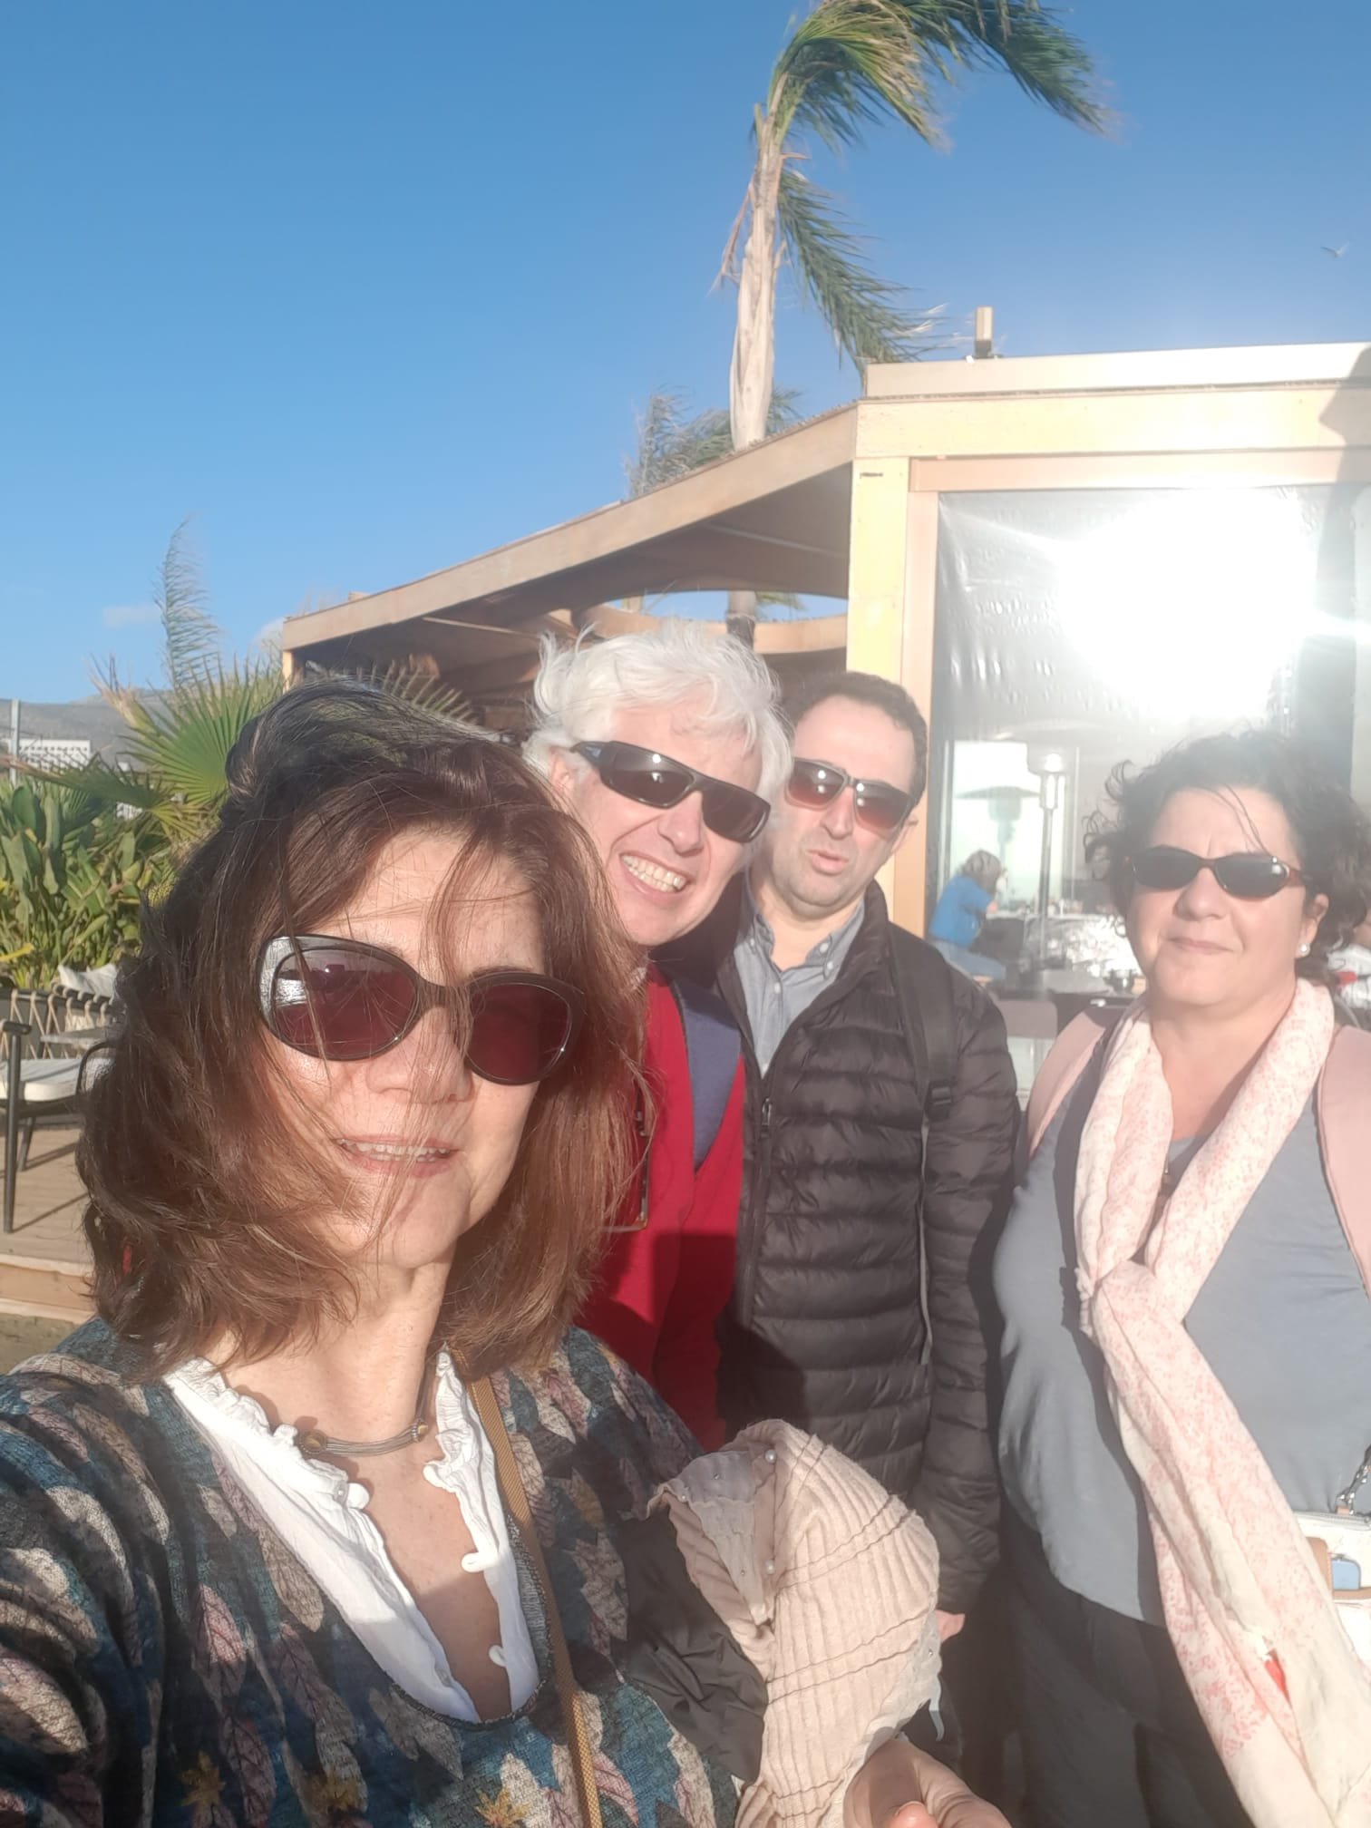
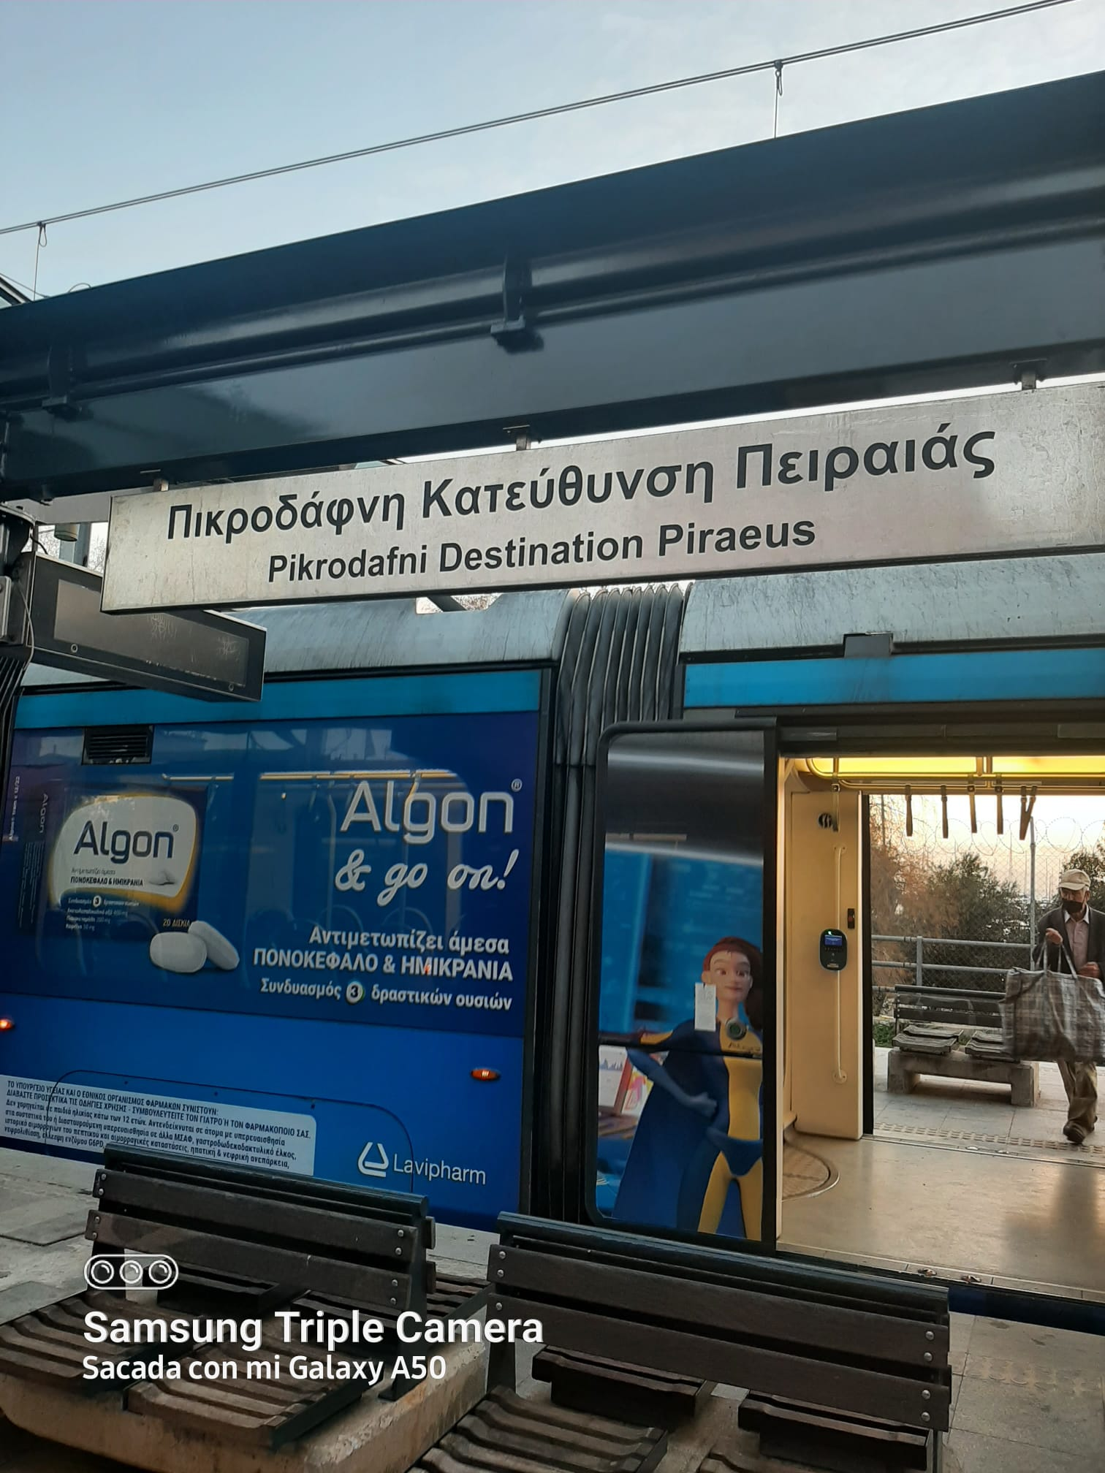
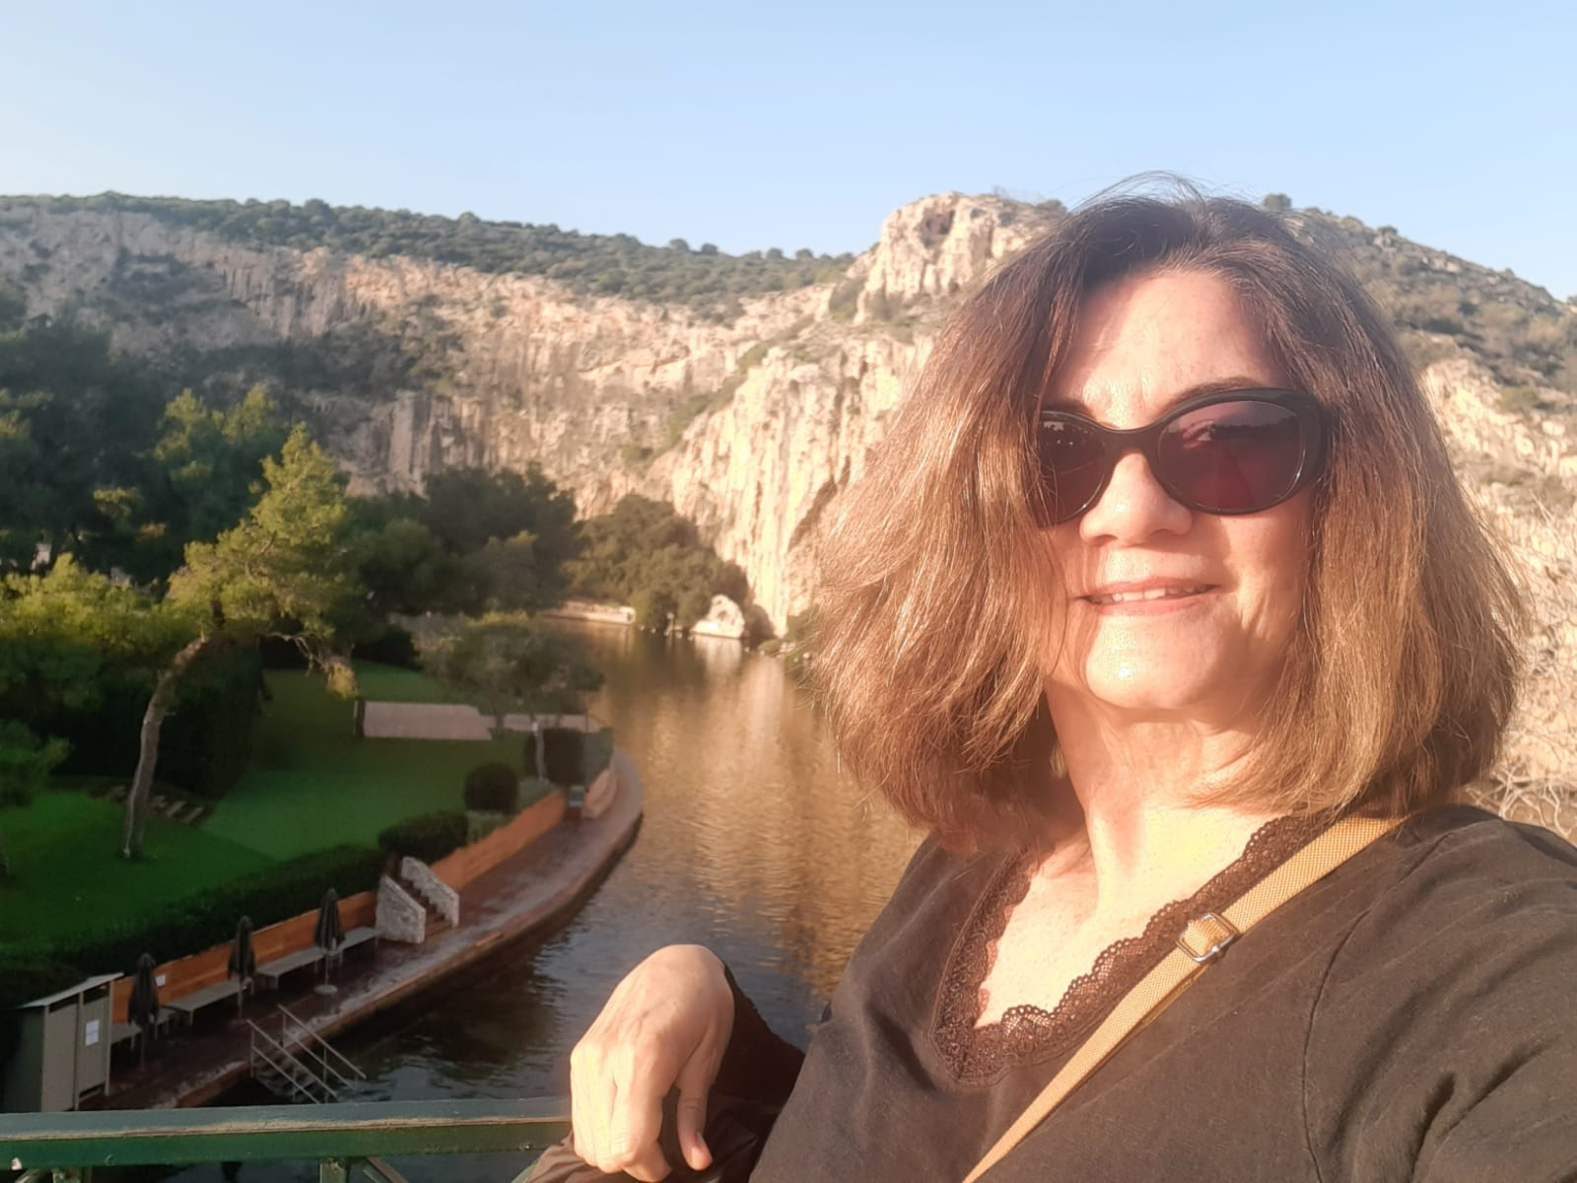
Glyfada, Greece
3-night stay at a hotel in a touristic city by the sea

Slide 10
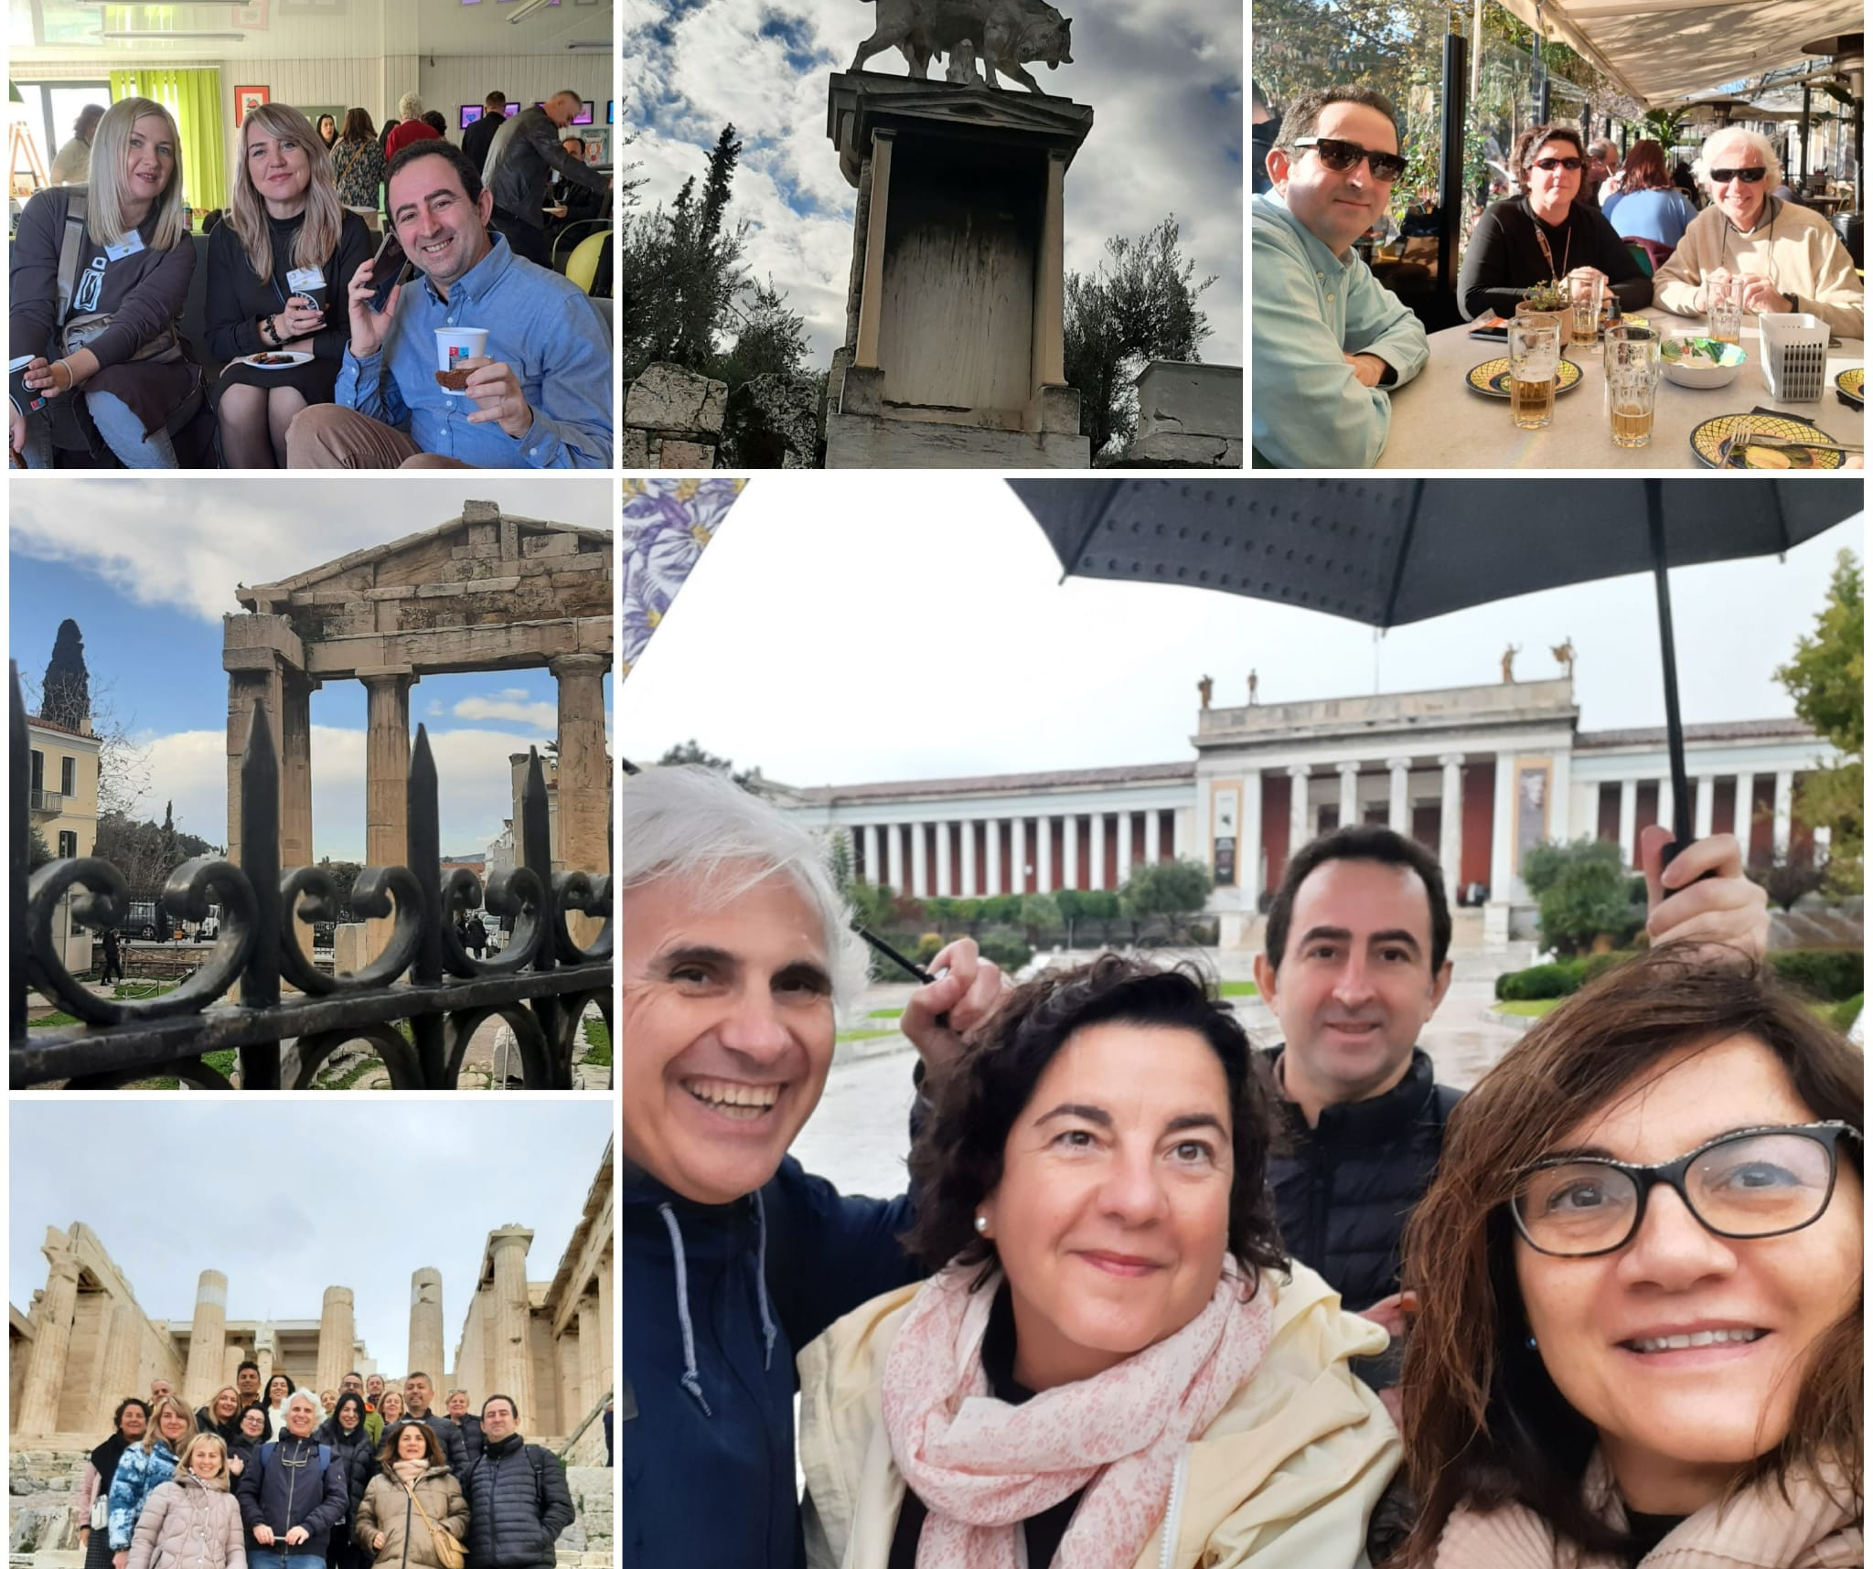
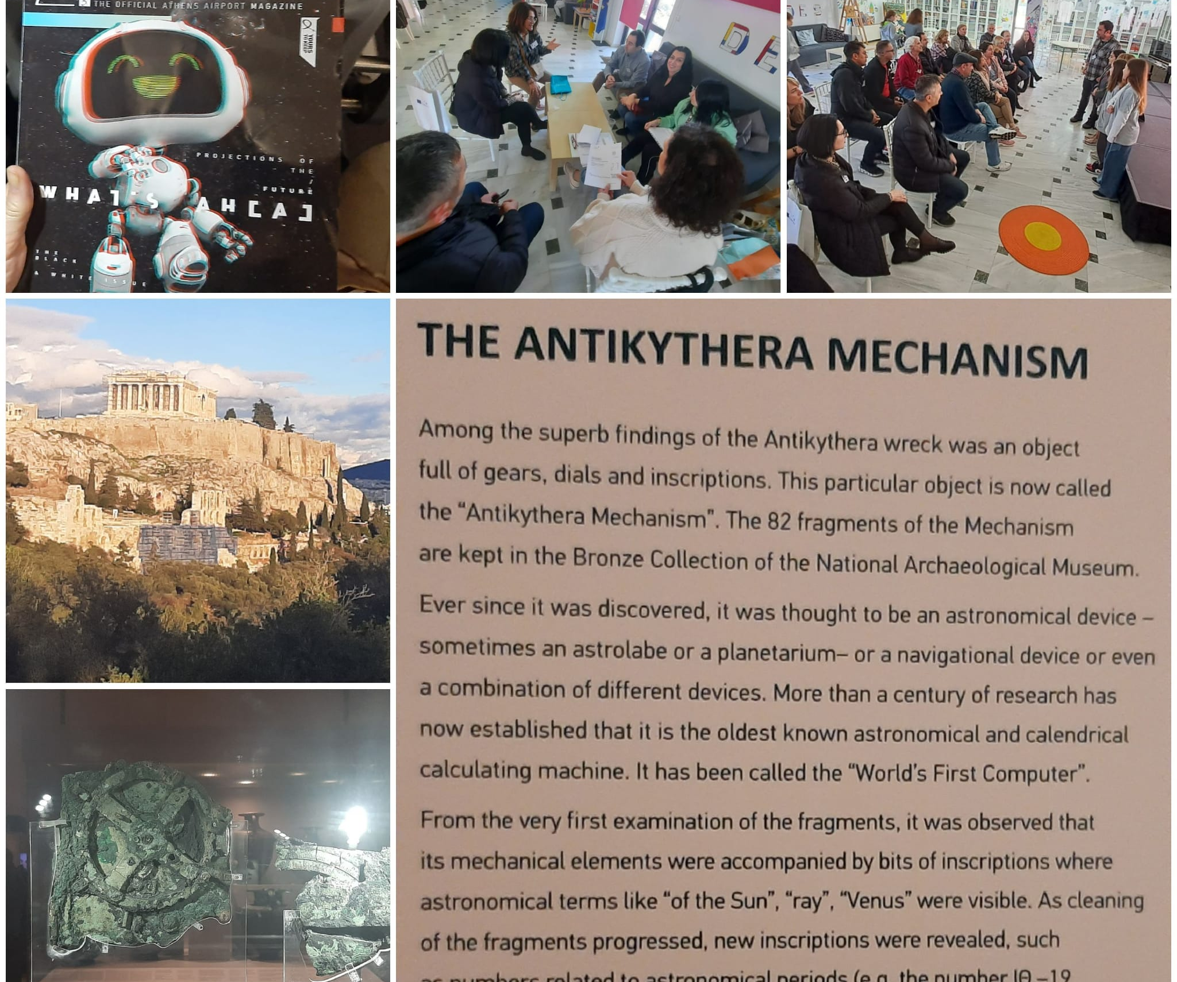
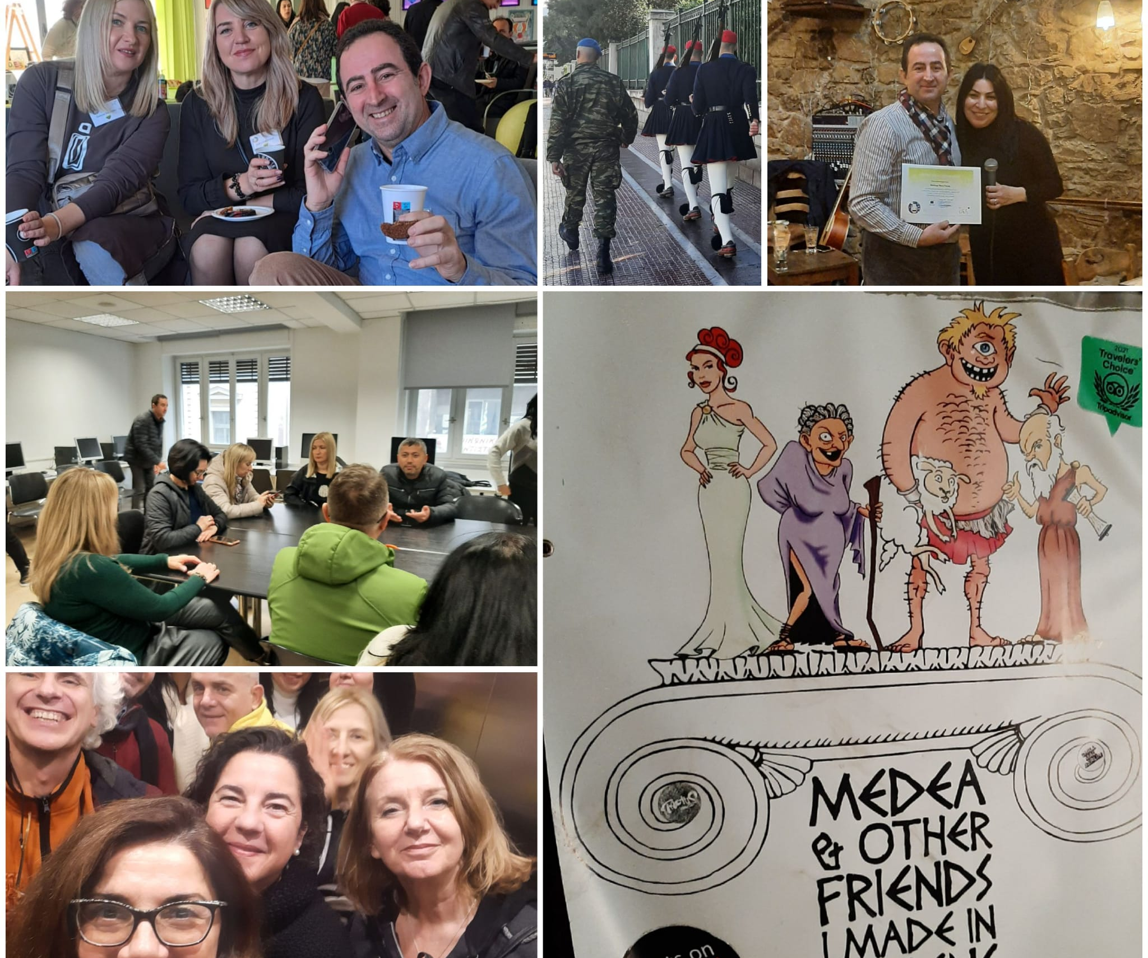
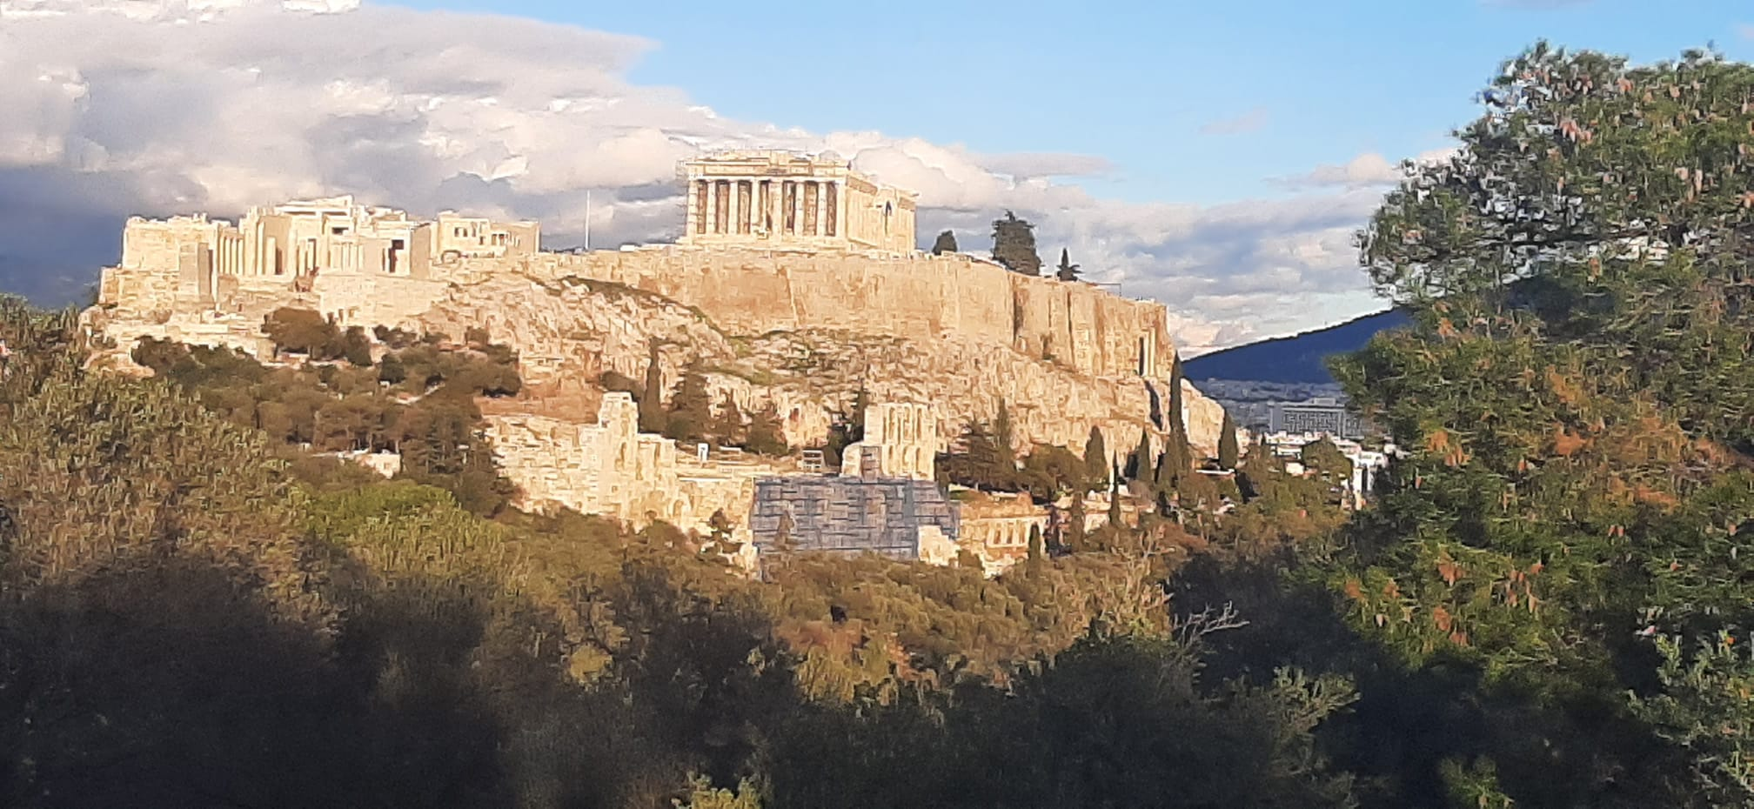
Athens, Greece
3-night stay in the city centre

Slide 11
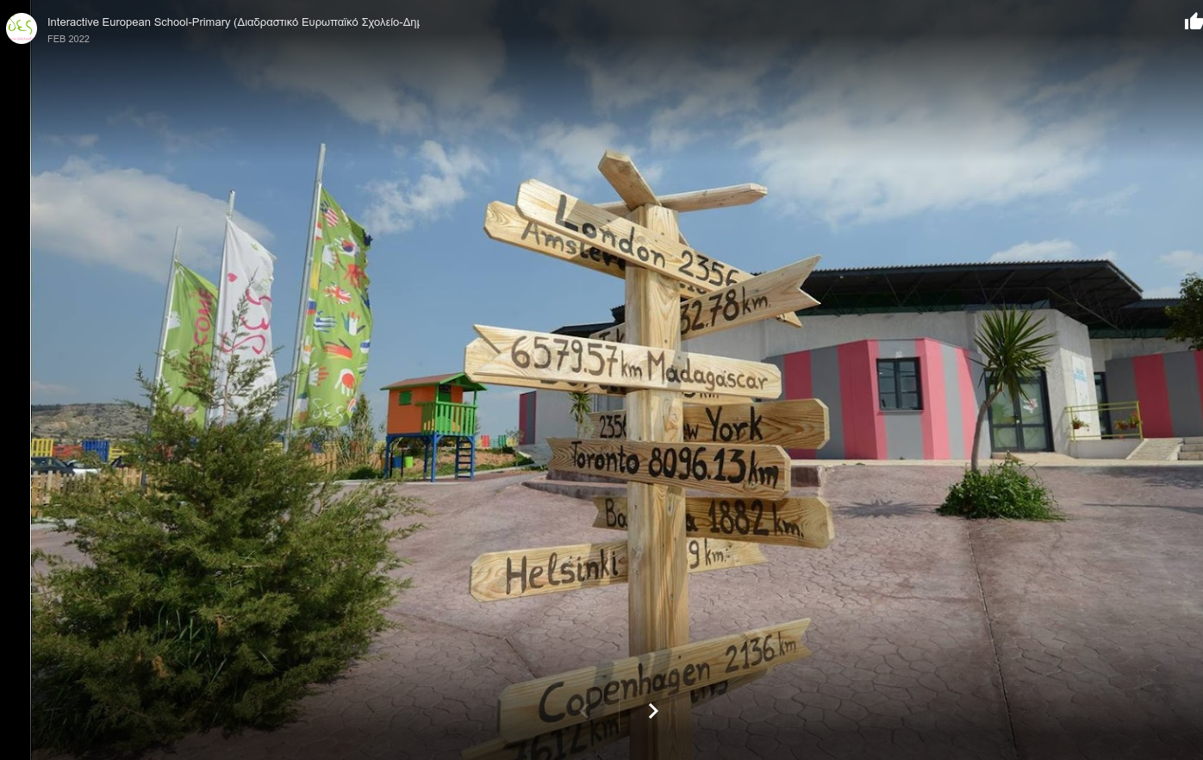
Barakos Hill-above Ribas Varkiza, Greece

Slide 12
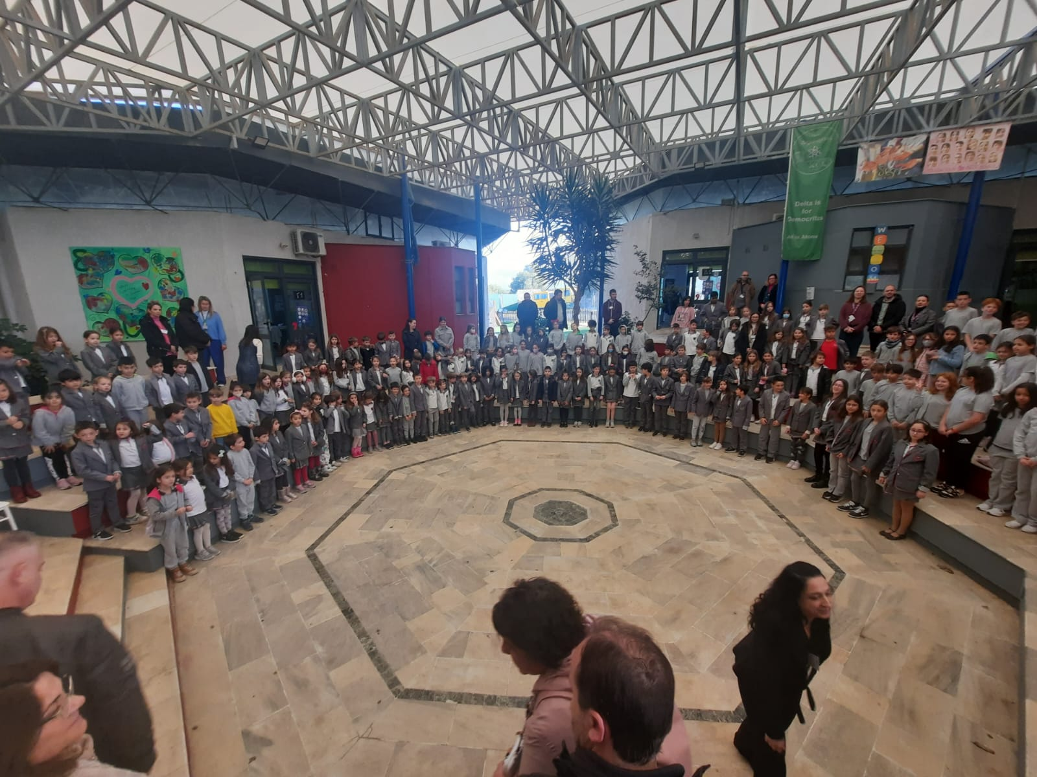
DES Interactive European School - Primary
"The first bilingual school in Athens that combines the Theory of Multiple Intelligences, with the prestigious International Baccalaureate Primary Years Programme (IB PYP), which aims to prepare students to be active participants in a lifelong journey of learning. -We strive to make children confident and creative builders of their future, through an inspiring, broad and engaging curriculum. Fun, creativity, engagement, independent learning, curiosity, critical thinking and collaboration are at the heart of everything we do. Our pupils are encouraged to meet academic challenges with openness, enthusiasm, and a willingness to solve problems in an atmosphere of cooperation, care, trust and respect.-"

Slide 13
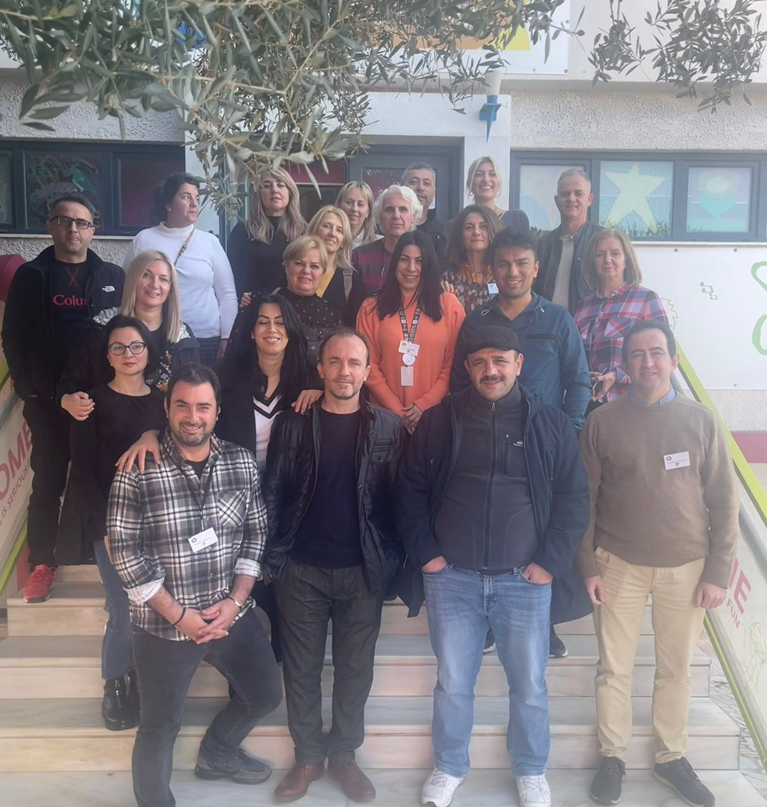
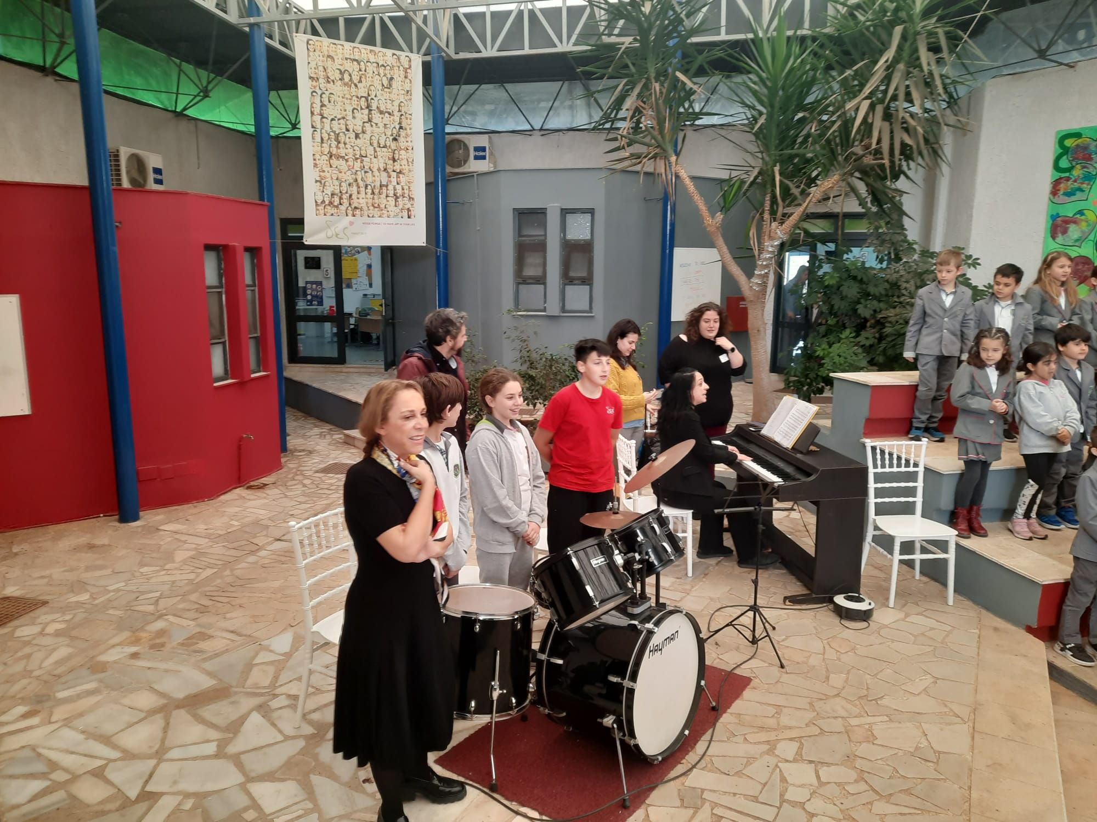
At DES School
Working sessions at DES School
Billy, the owner, and some teachers (right). The KA226 team (left).
Reception (down)

Slide 14
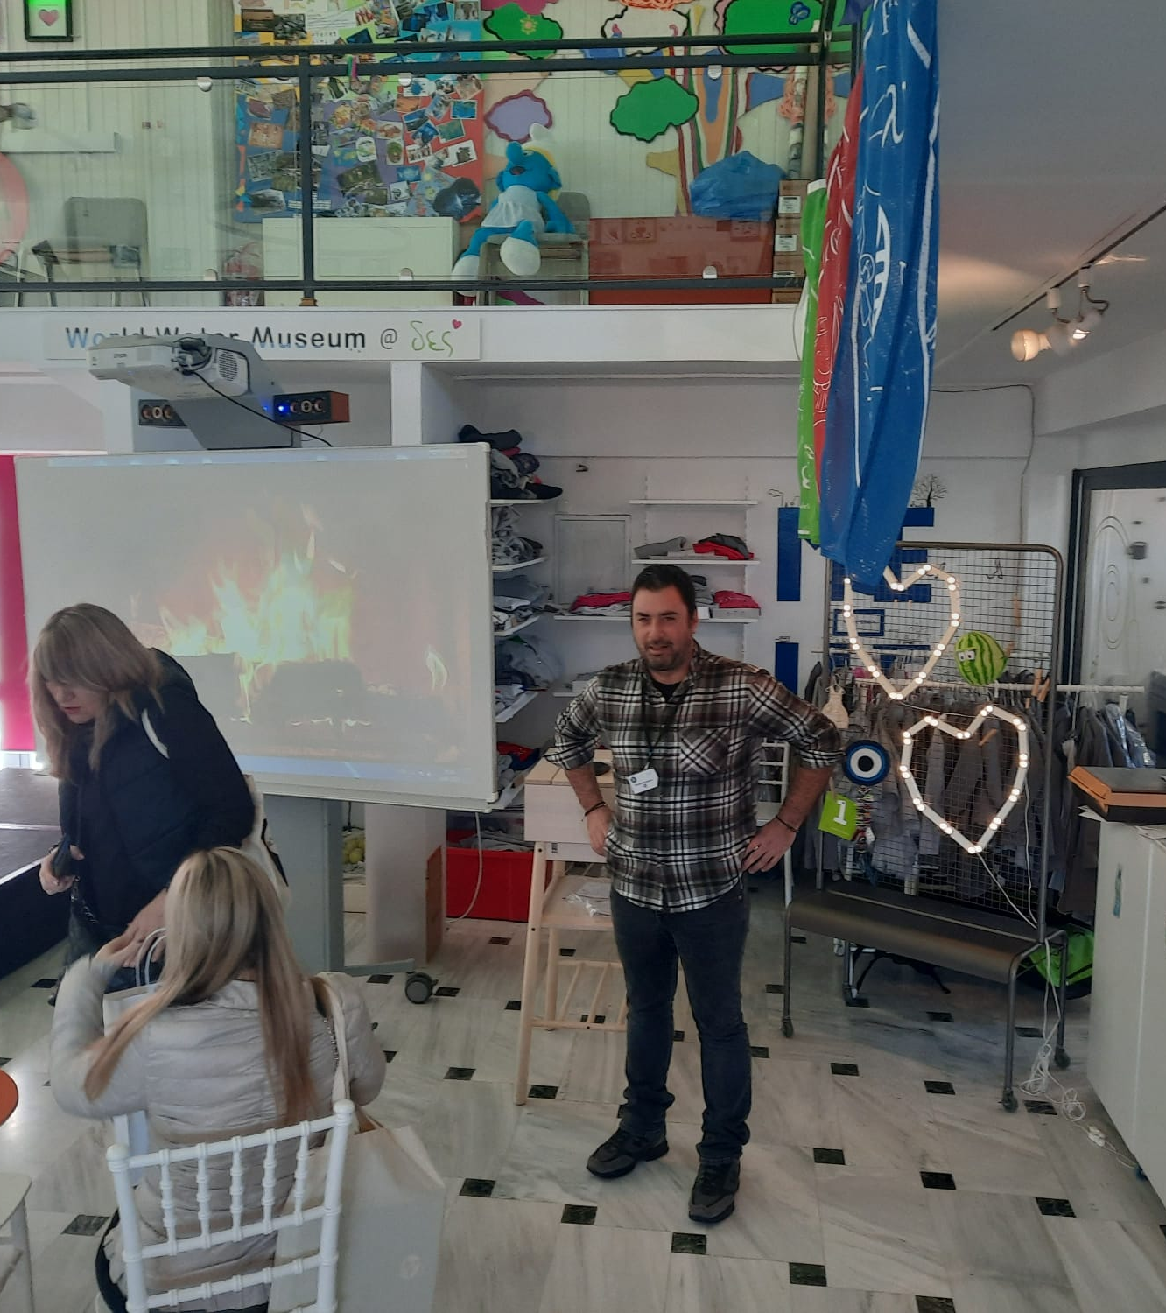
Mr Costas, Headmaster

Slide 15
Working Sessions
Visit to the school facilities guided by 6th grade students.
App Presentations:
Tangram with Osmo base.
Animated Maths, MathemARTics, programming with Python.
IB PYP Exhibition. Project Based Learning (students using digital tools).
PowToon/Bluestacks 5 video animation on bullying (STEM).
Wix blog set up by students.
WordPress to upload content from eTwinning.
Storytelling and new technologies at University using Kinemaster.

Slide 16
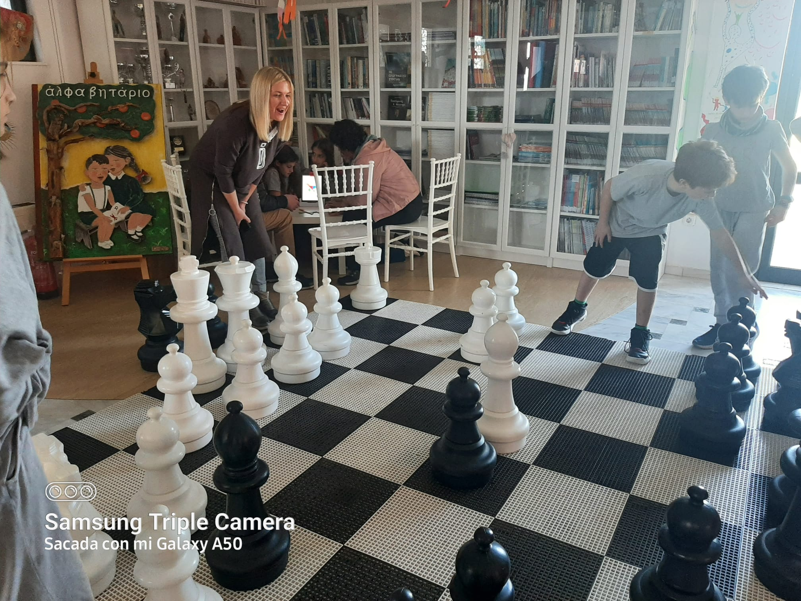
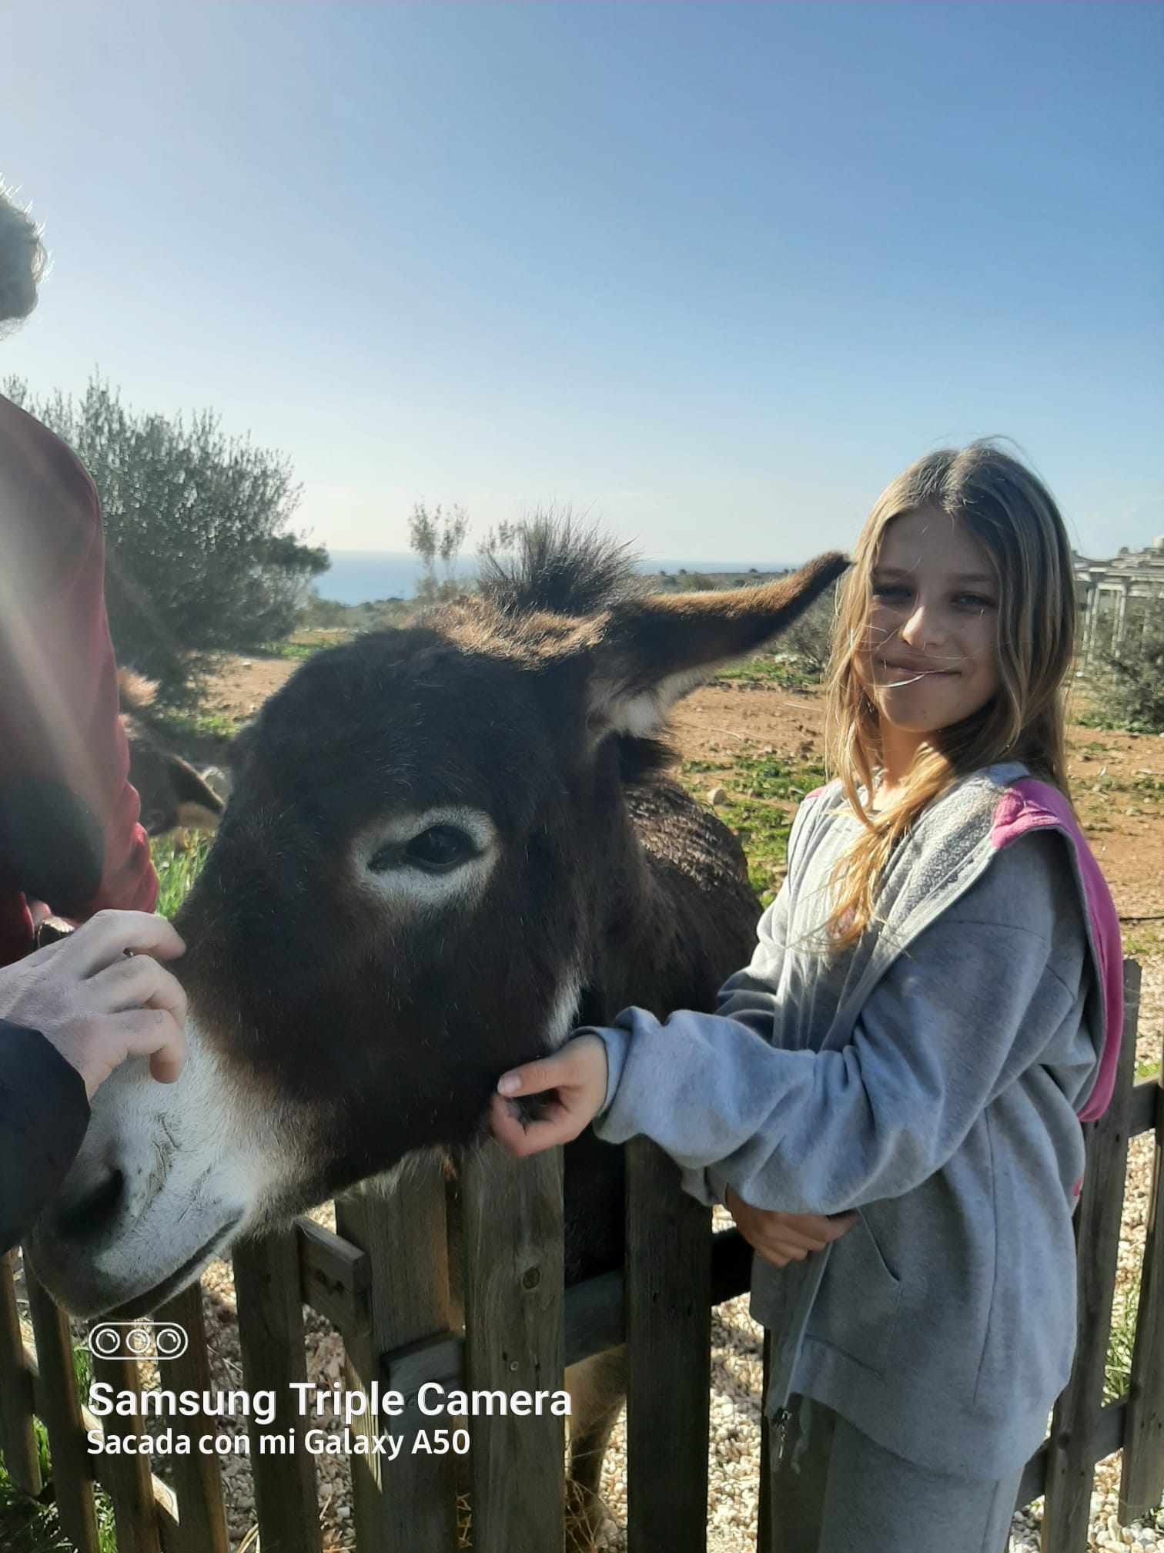
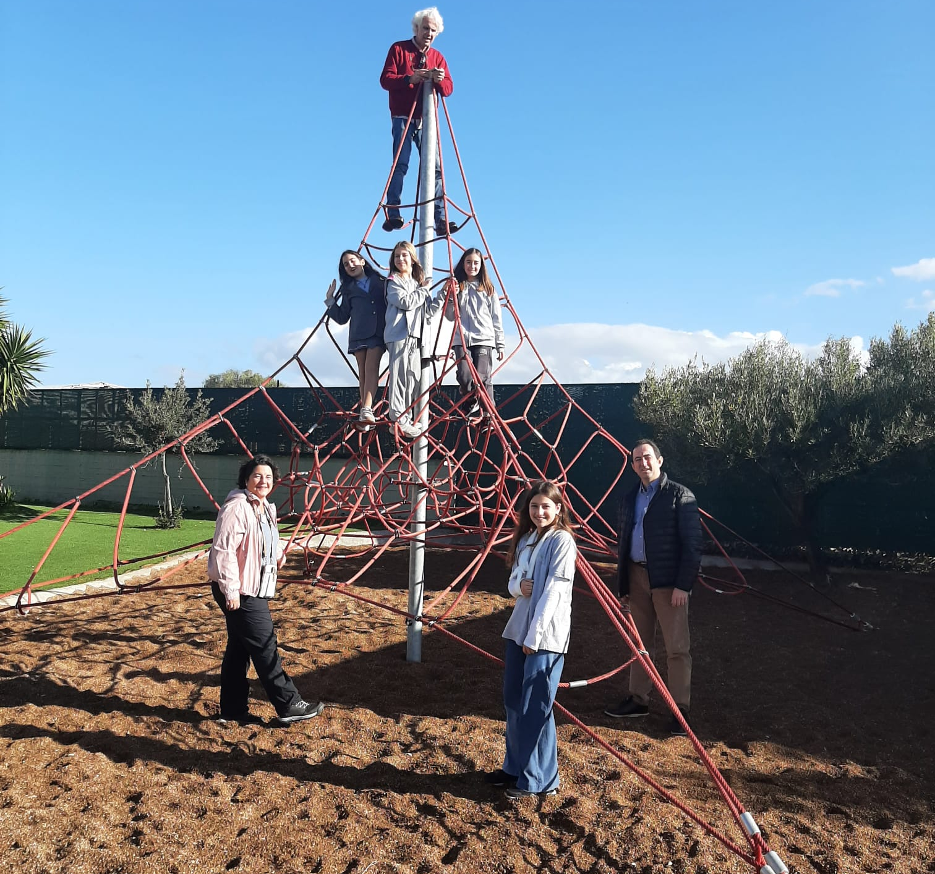
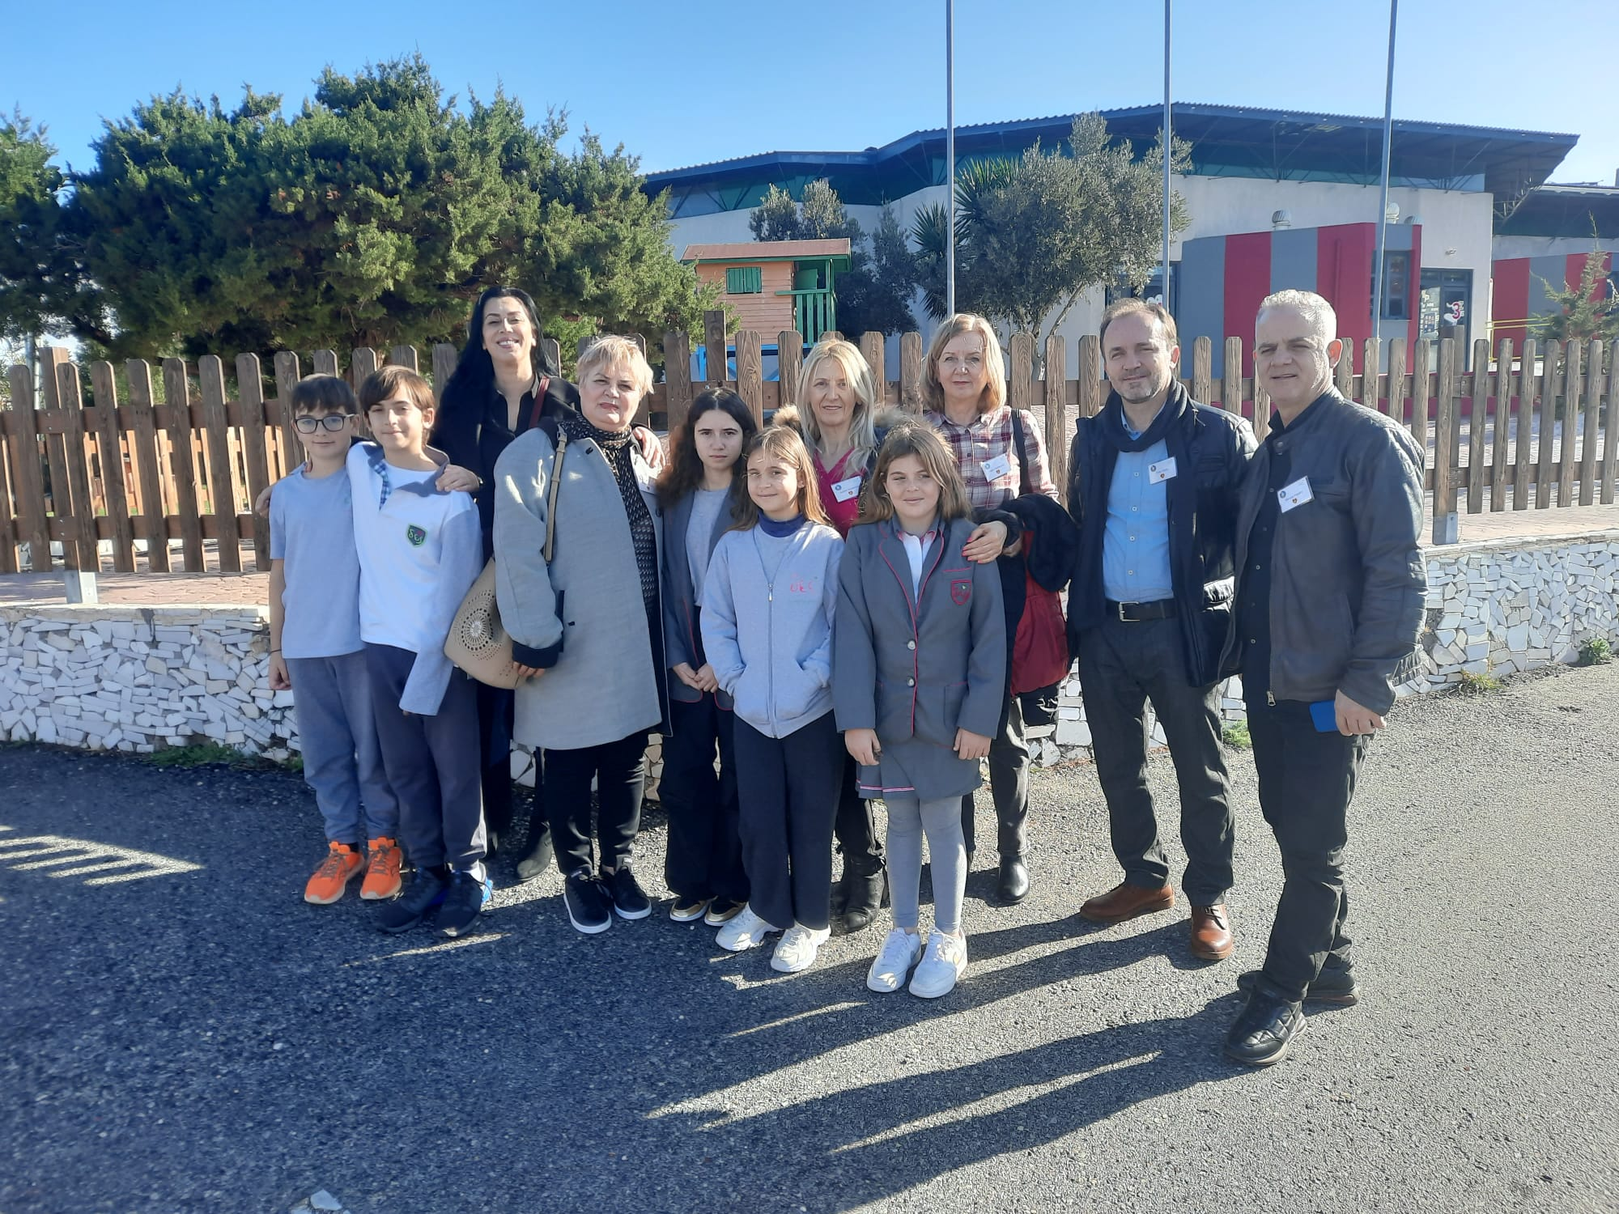
Our English speaking 12 year-old guides!

Slide 17
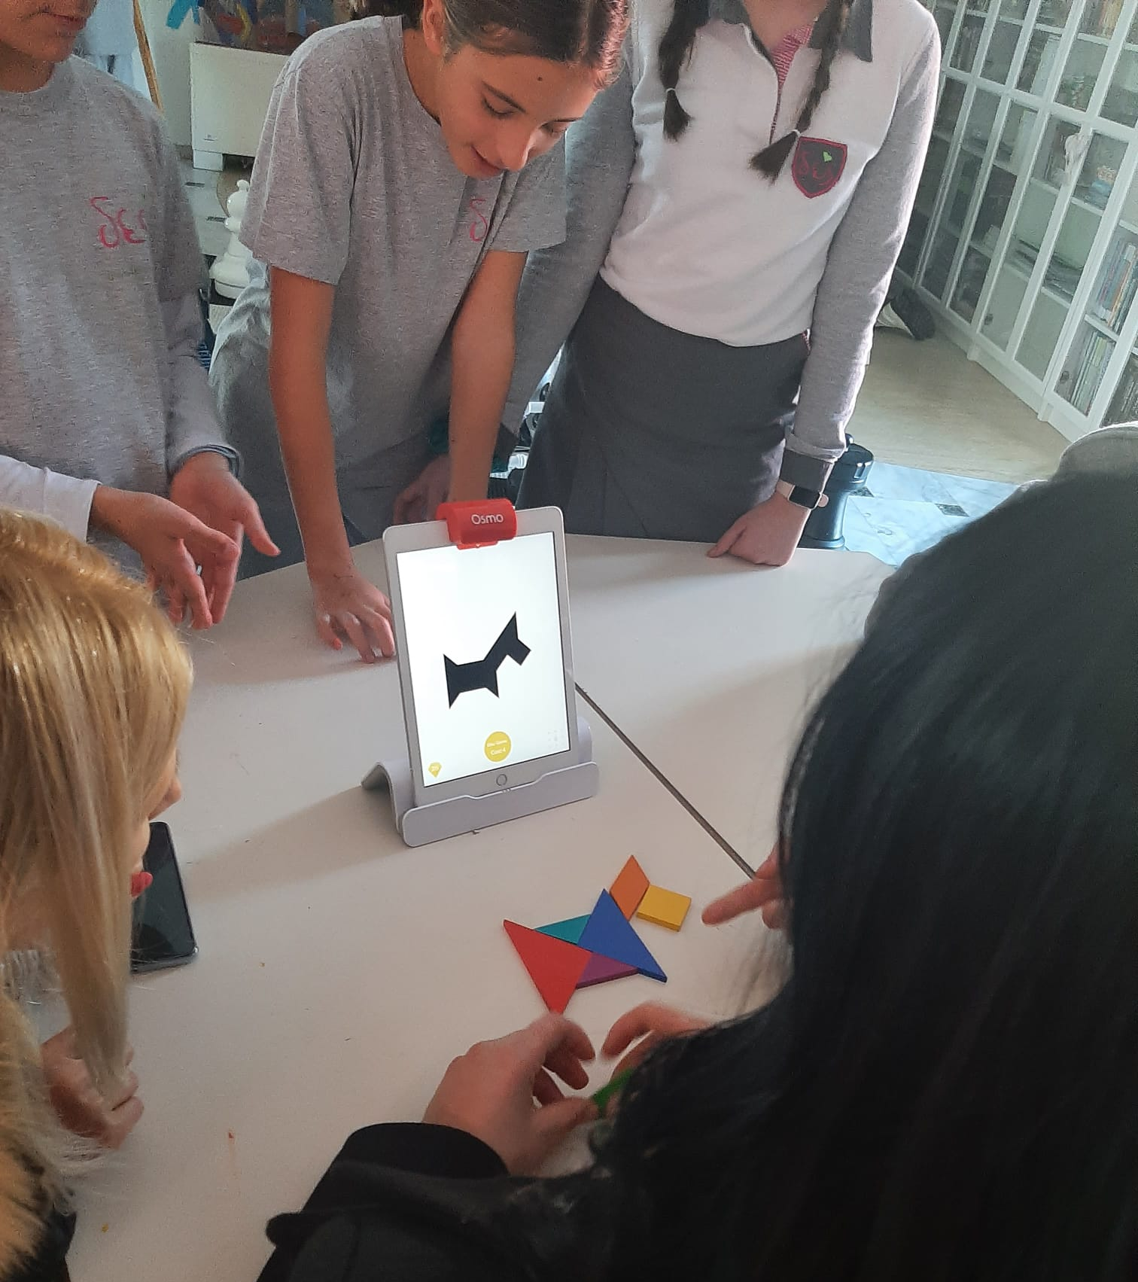
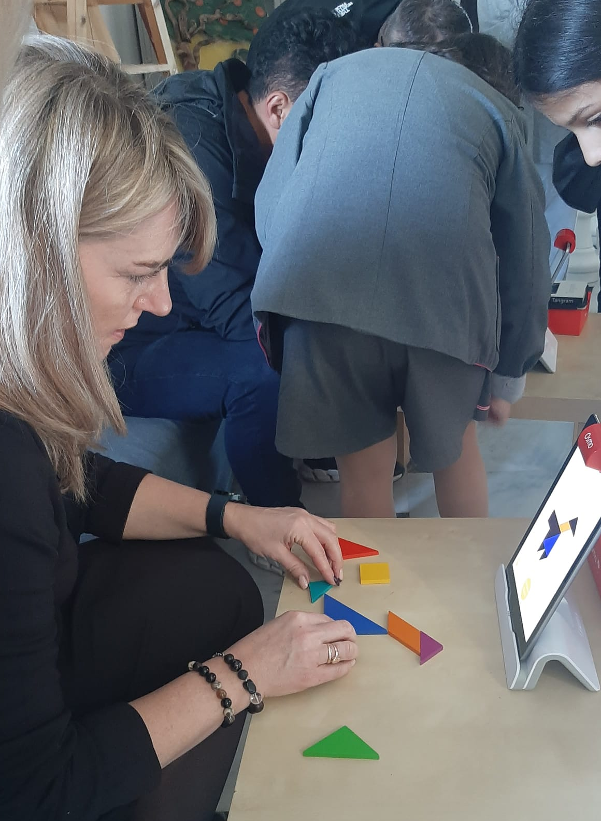
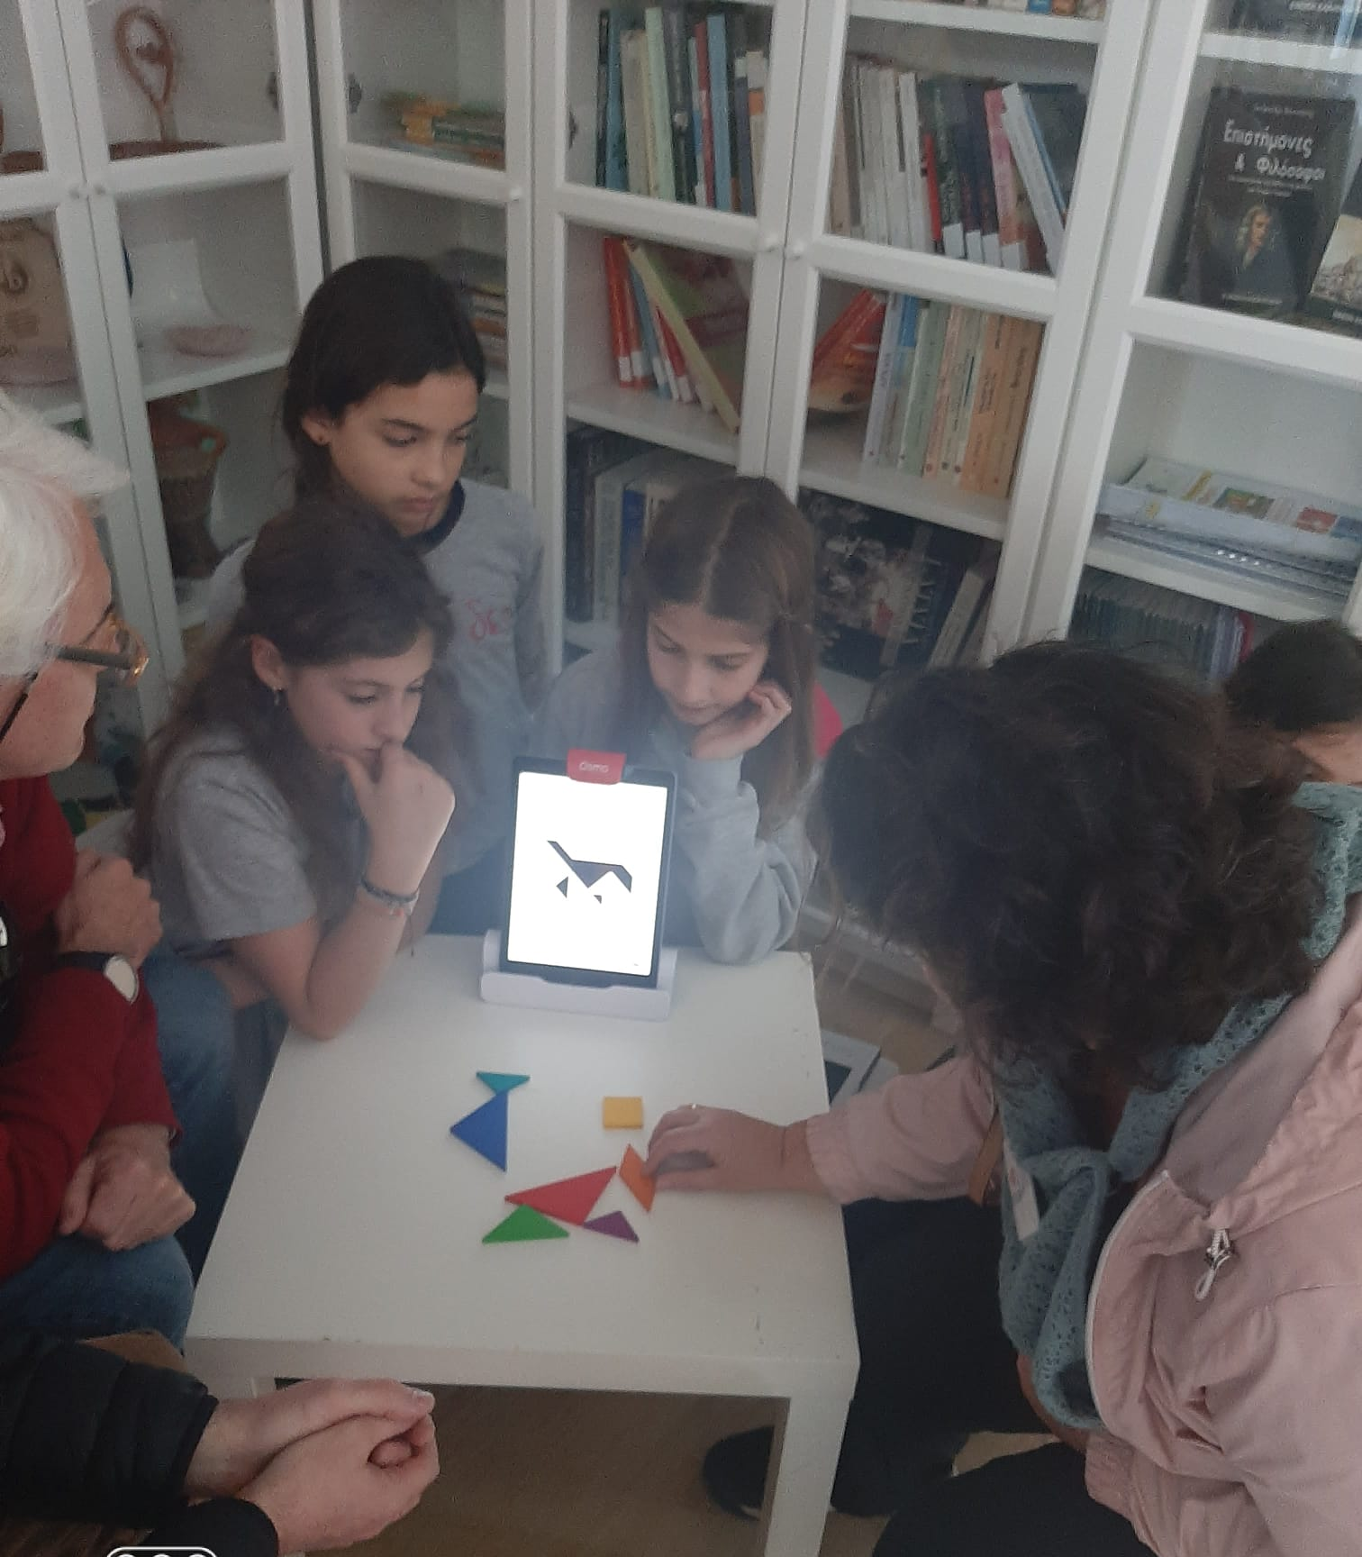
Tangram with Osmo. Teamwork

Slide 18
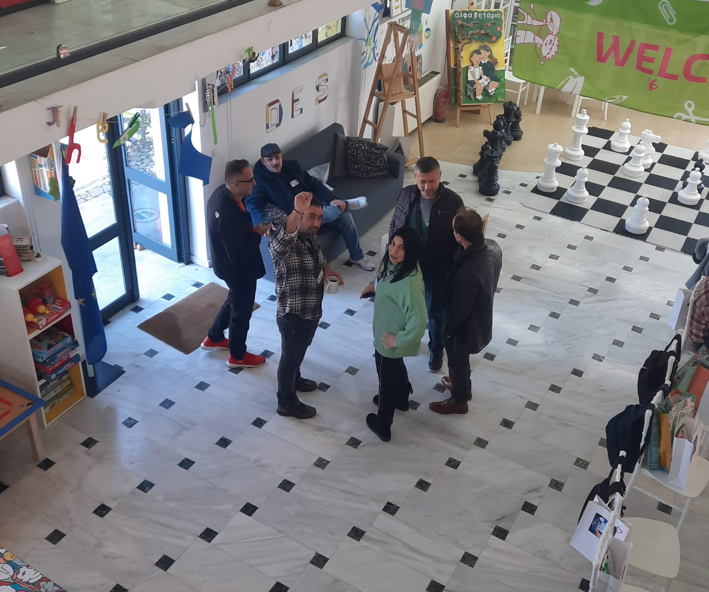
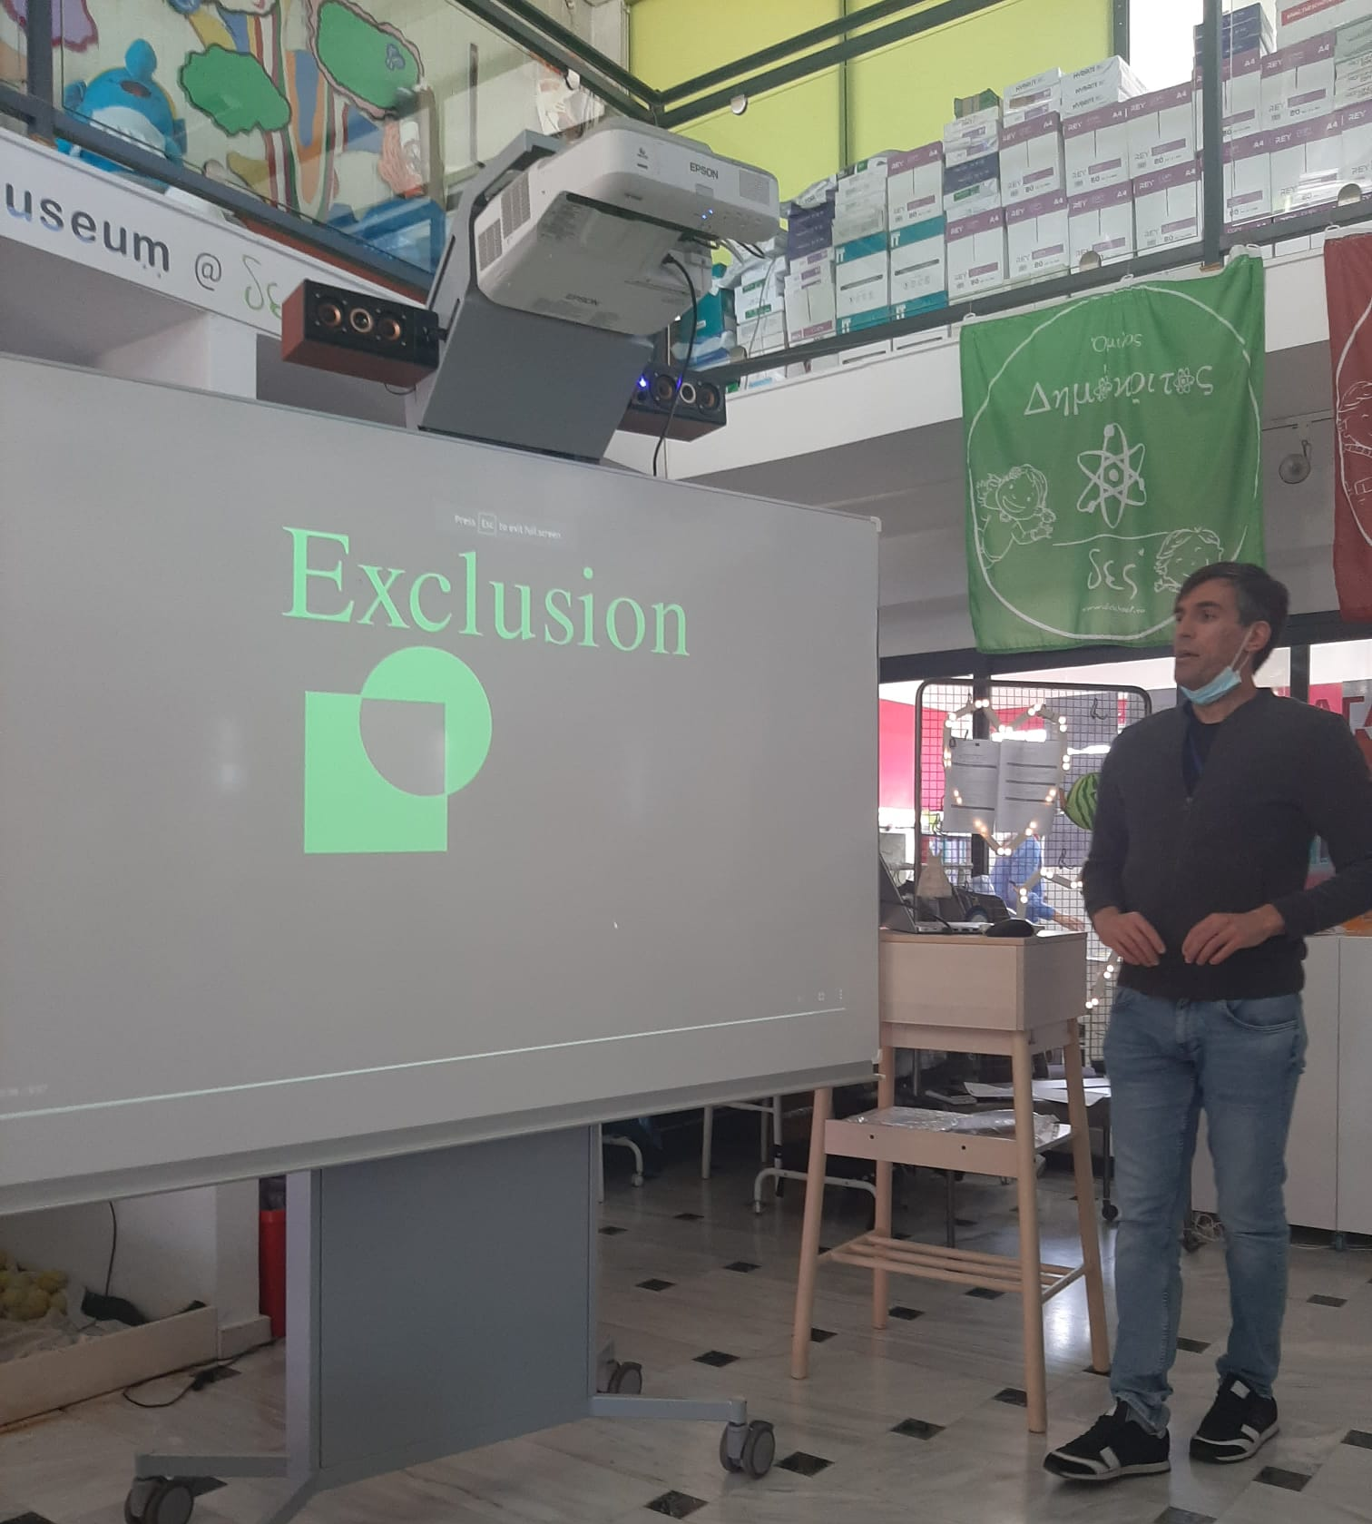
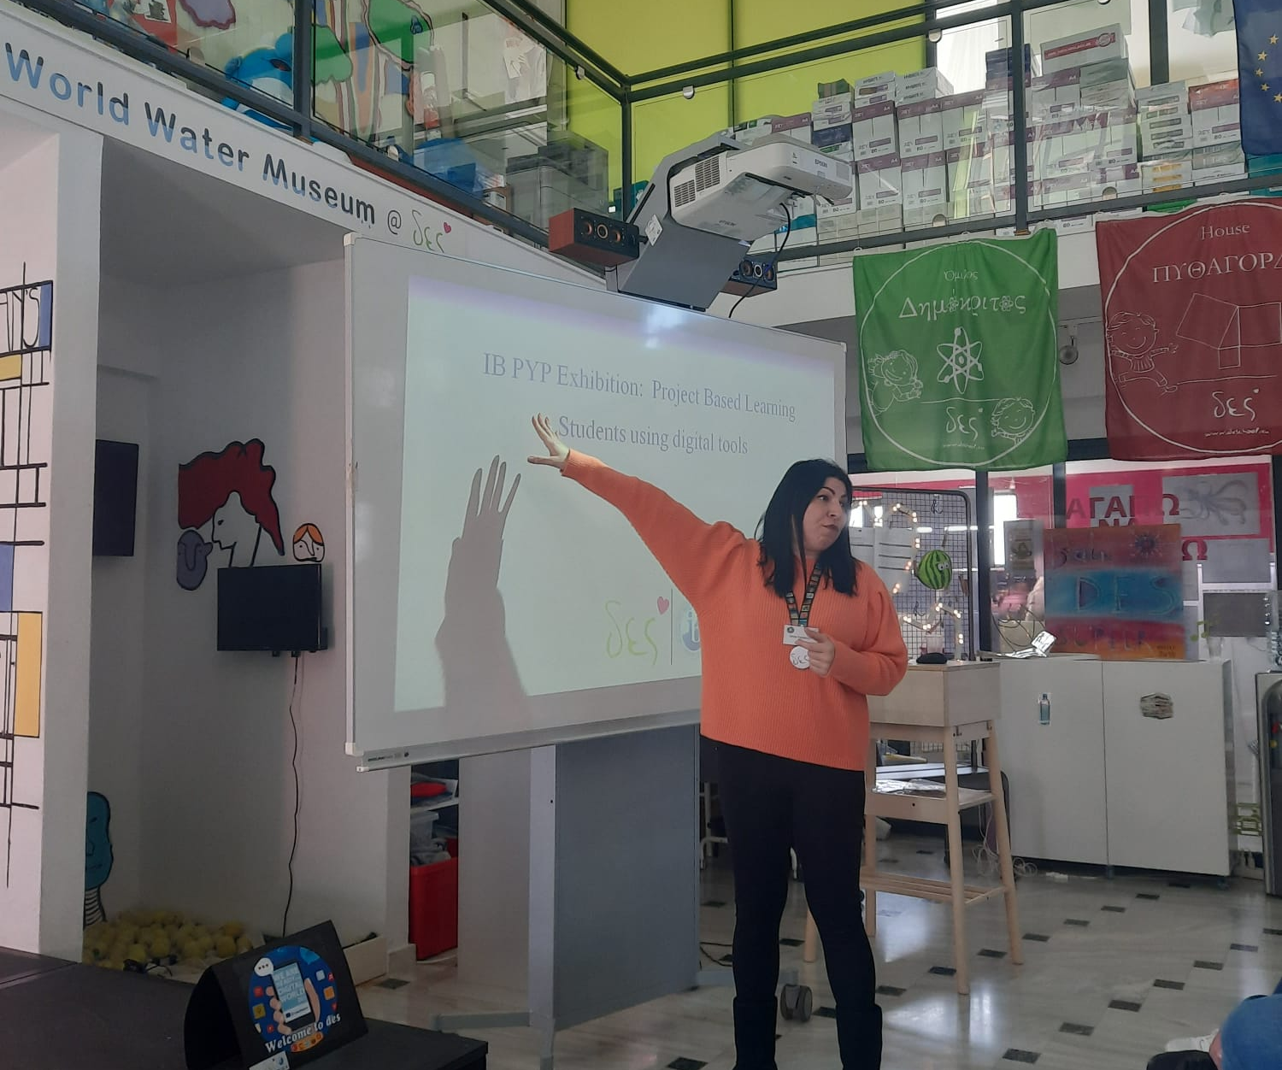
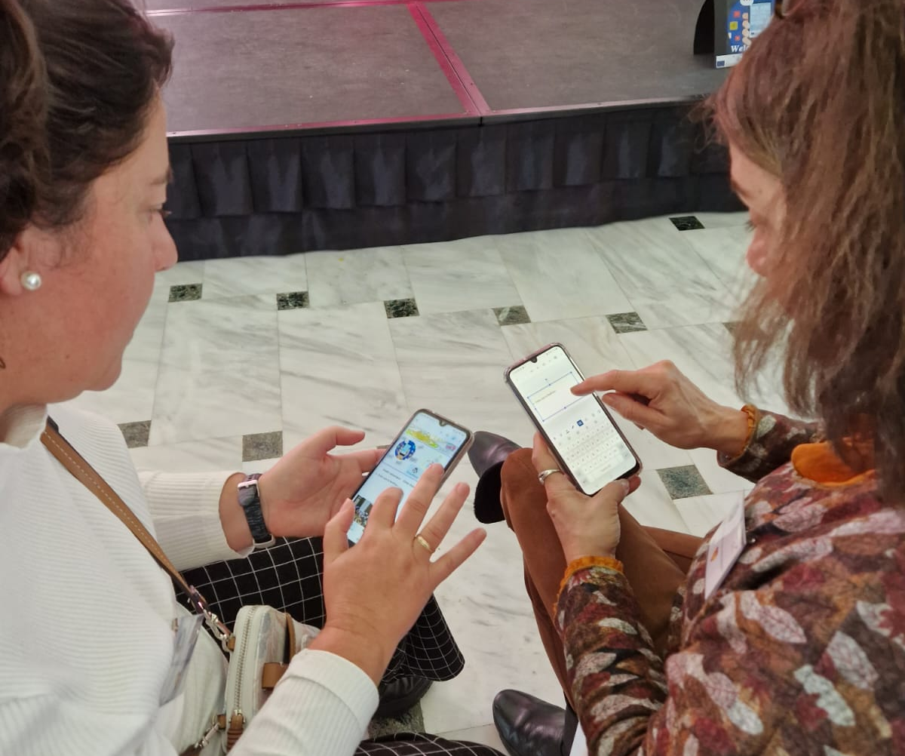
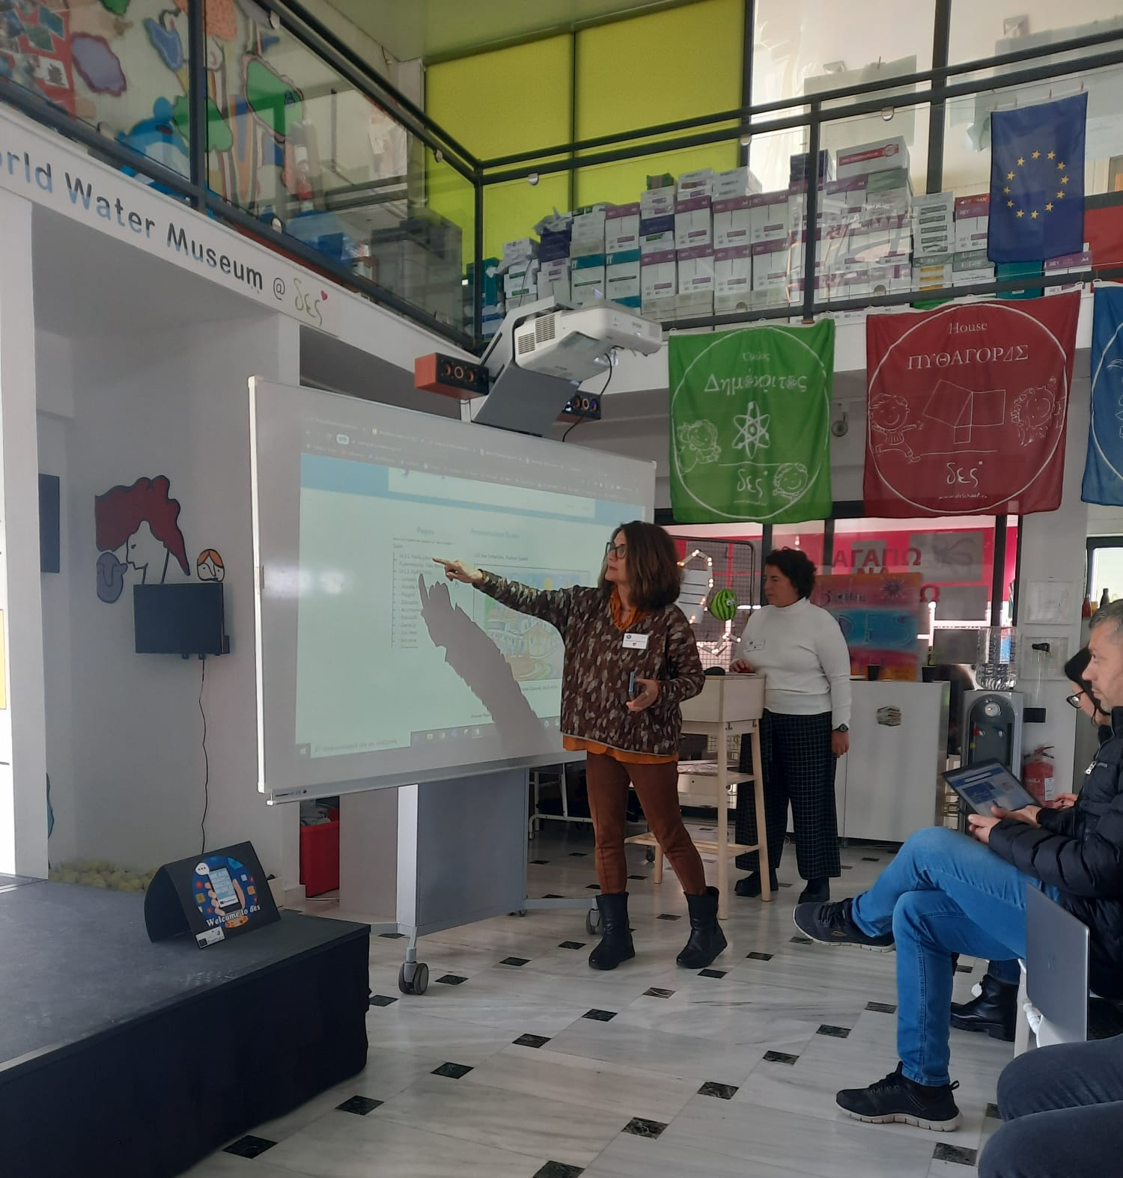
Mr Evan Ginis
Ms Xenia
Mrs Ana G and Ms Carmen N

Slide 19
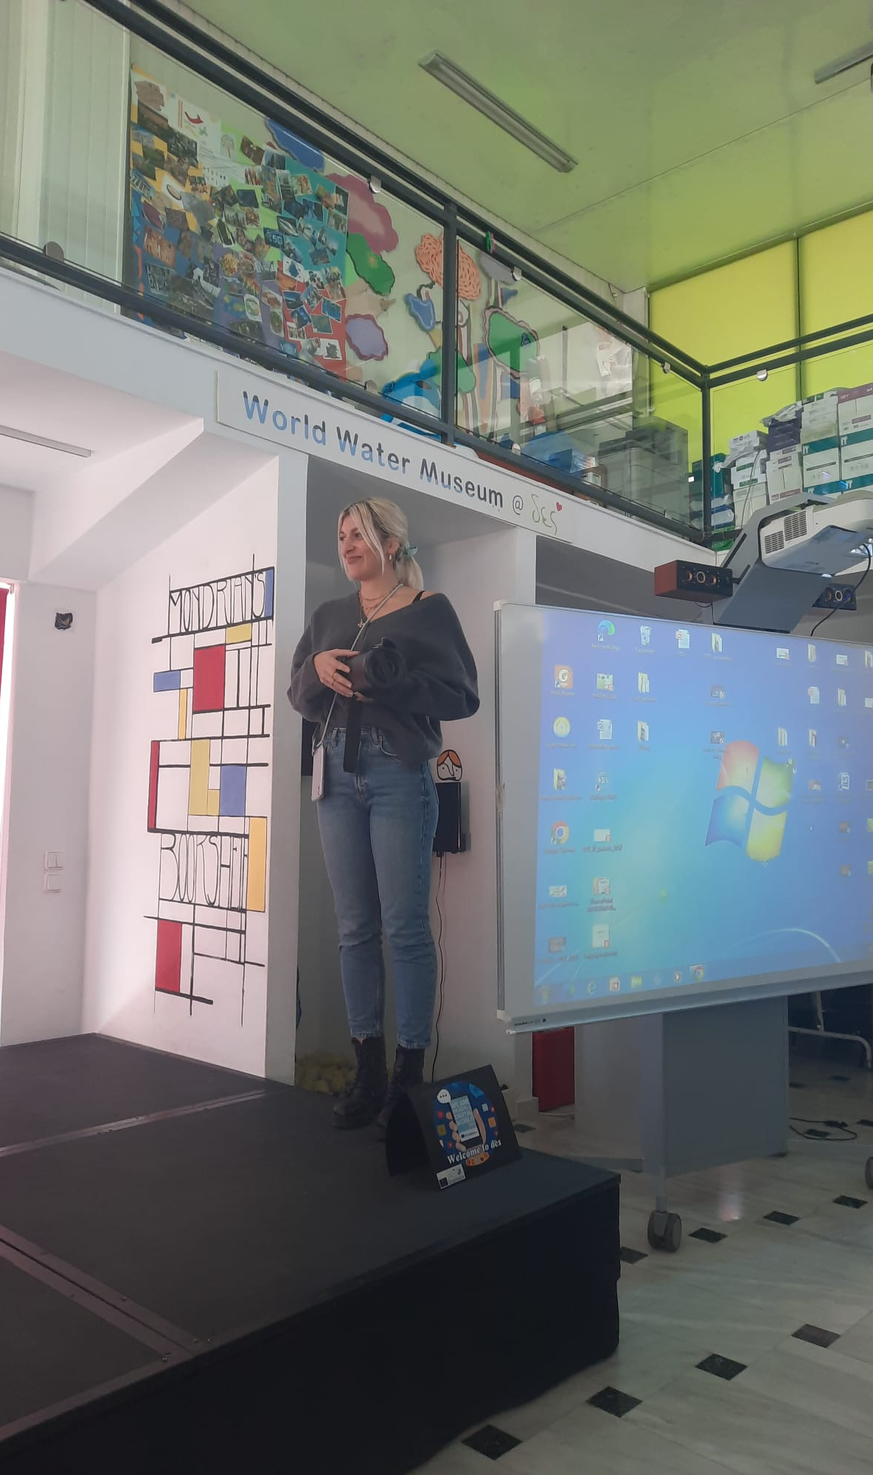
Kid’s presentations: STEM Project
Ms Elena

Slide 20
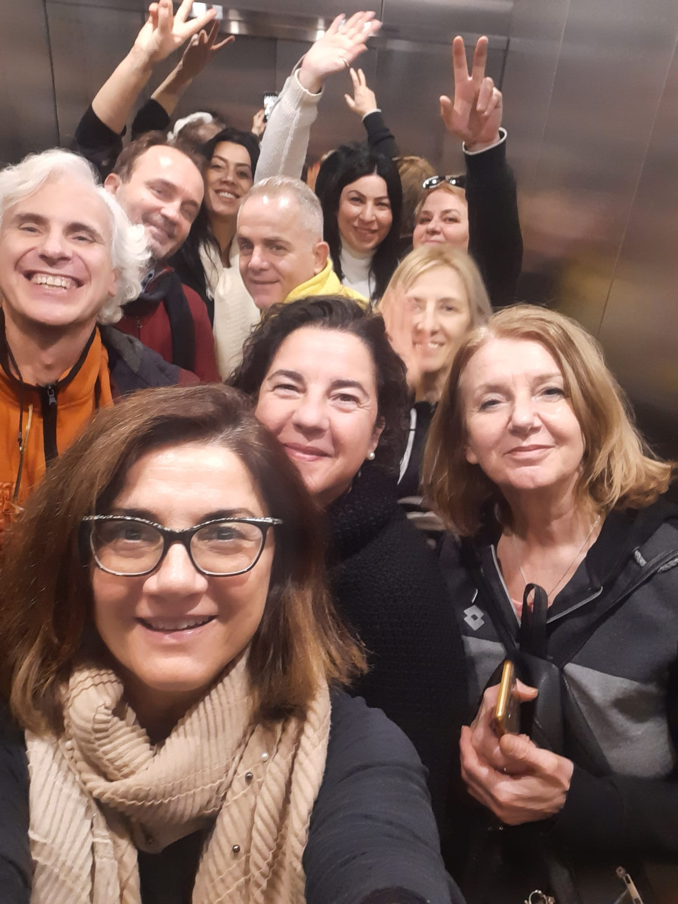
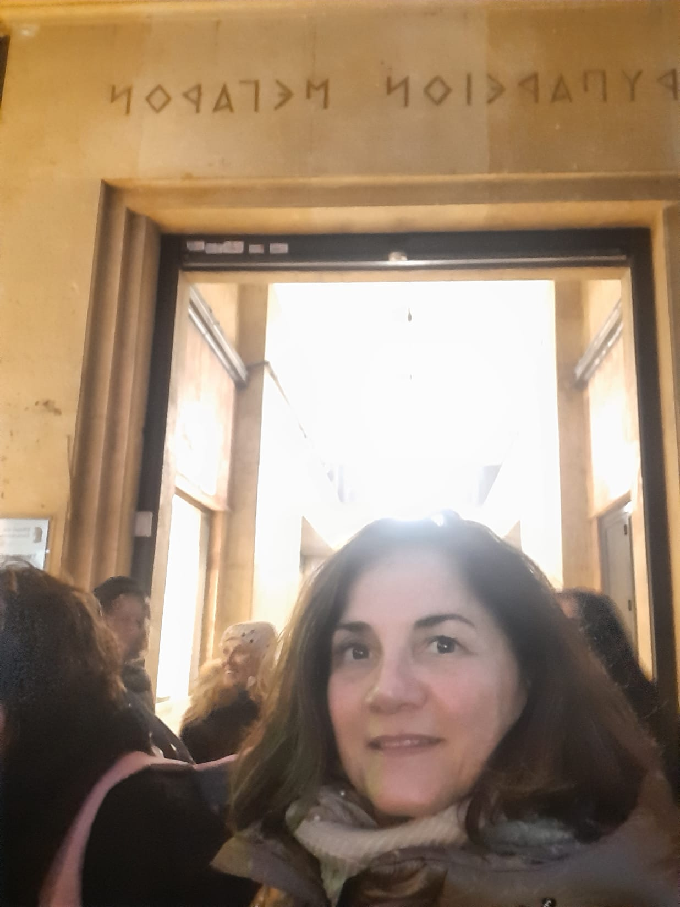
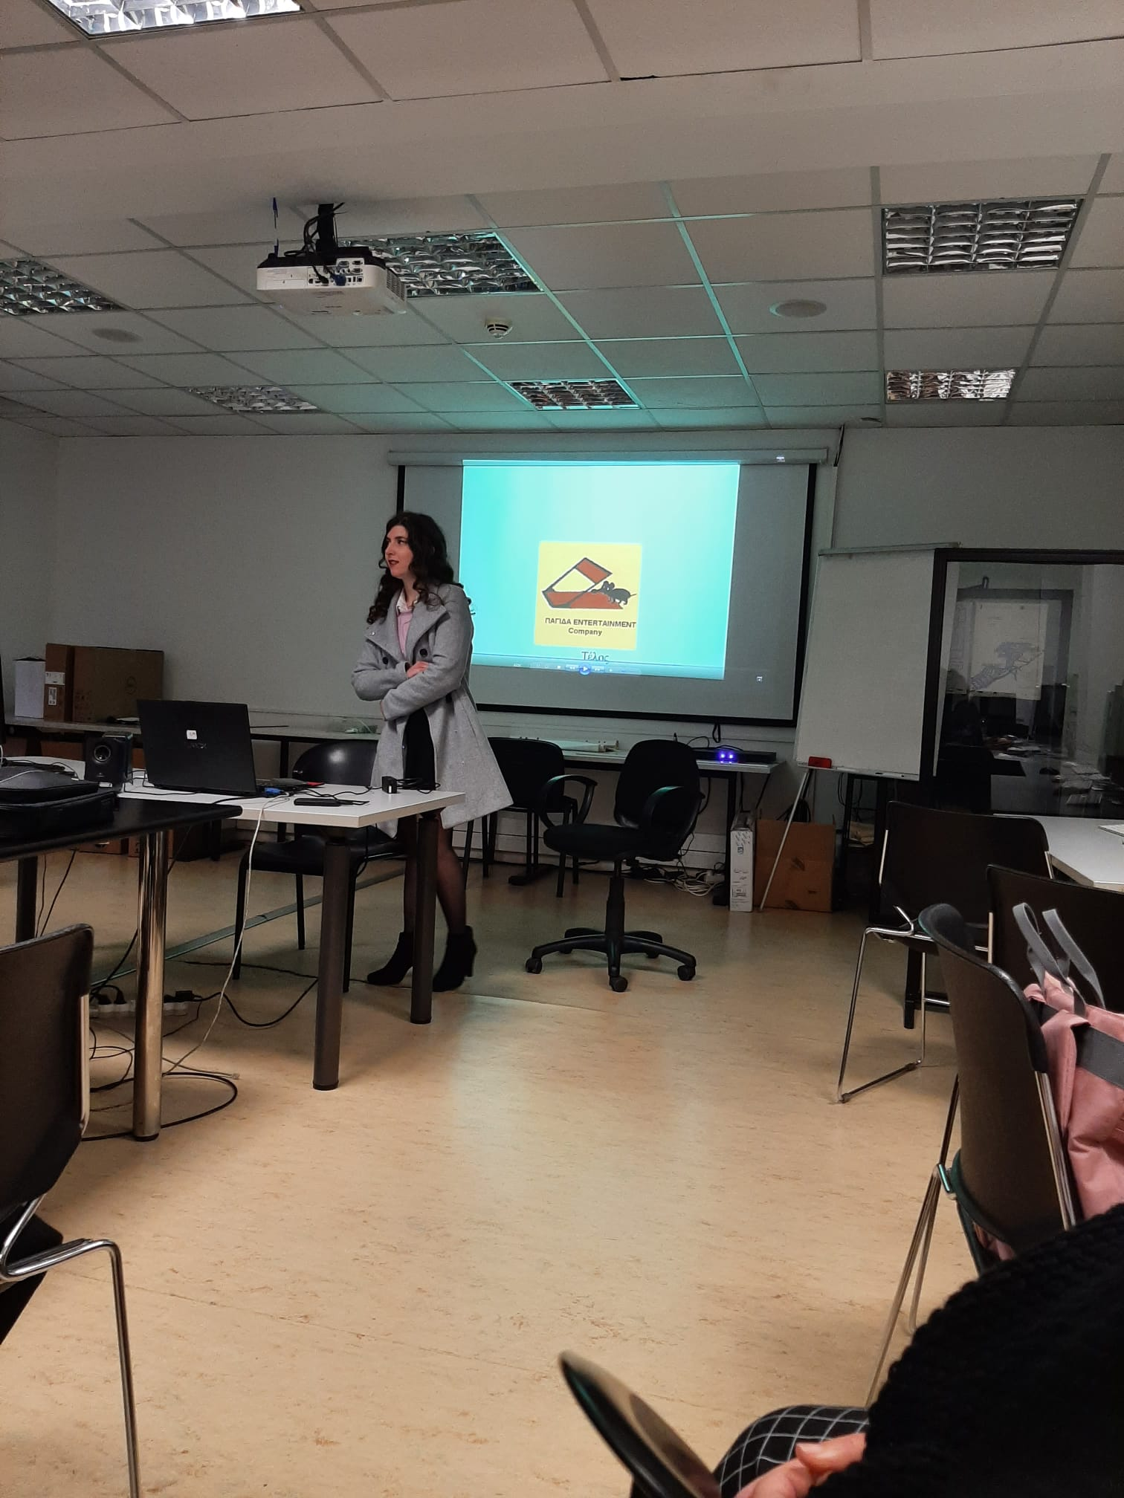
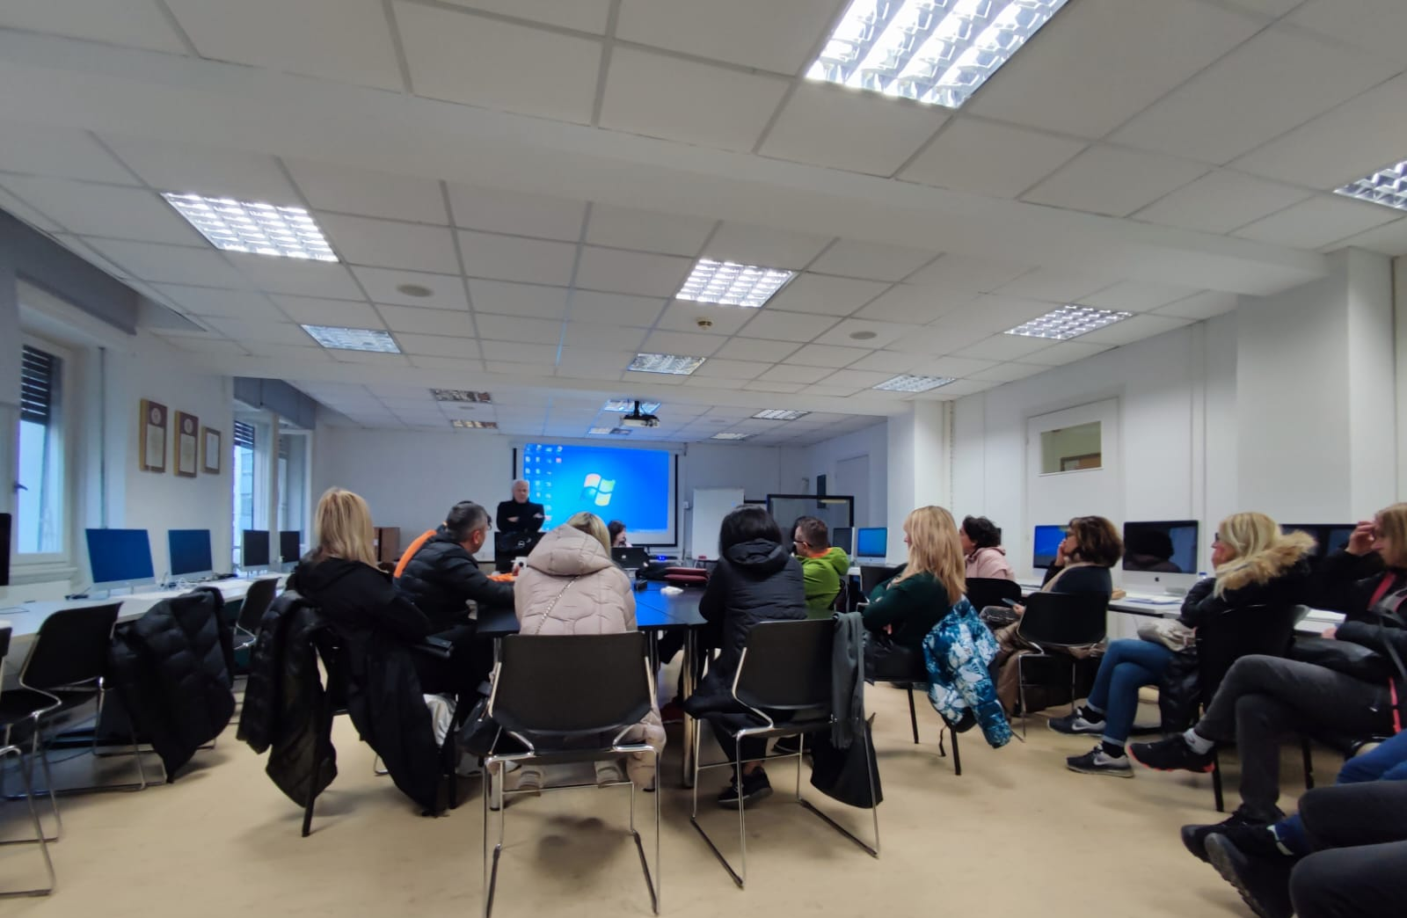
Digital Storytelling. AI. Big Data. Create the right environment to adapt everything to the interest of students. Communication. Soft & Digital Skills.
Create your own stories using Kinemaster

Slide 21
It’s time to chillout!
At the Archeological Museum
Sightseeing
Farewell dinner
Certificate delivery

Slide 22
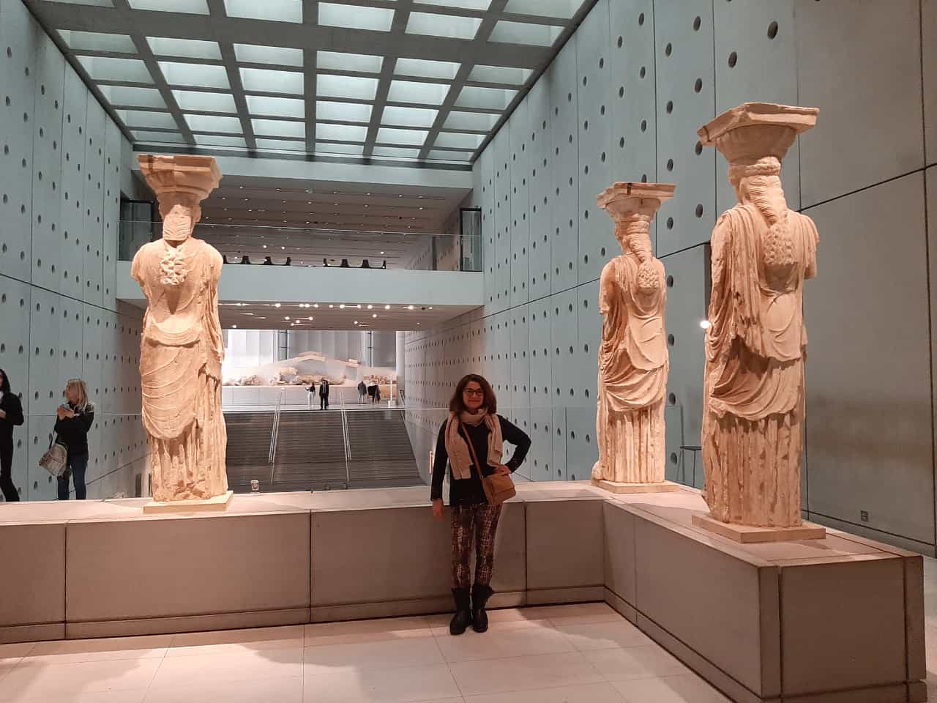
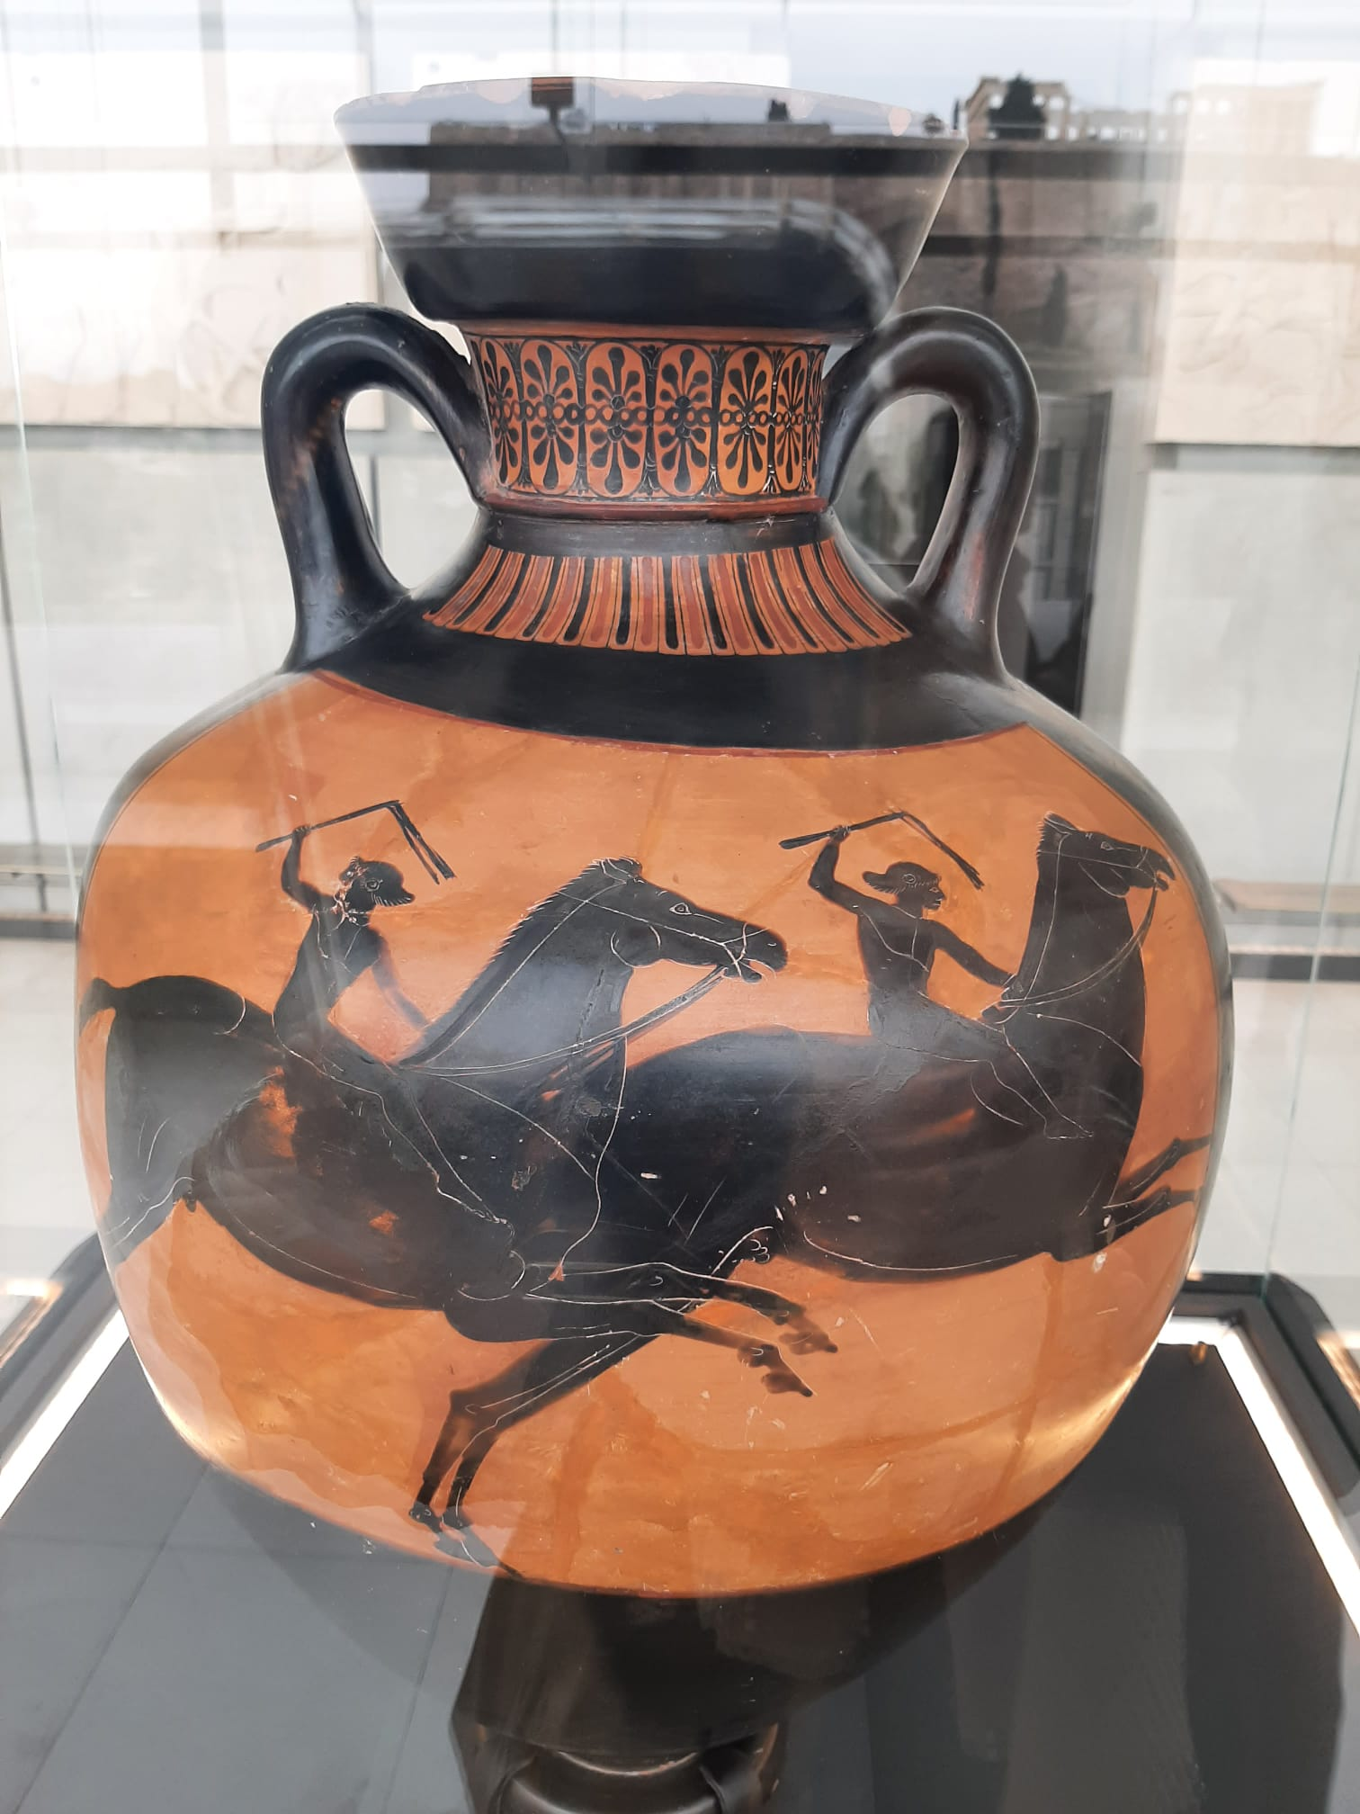
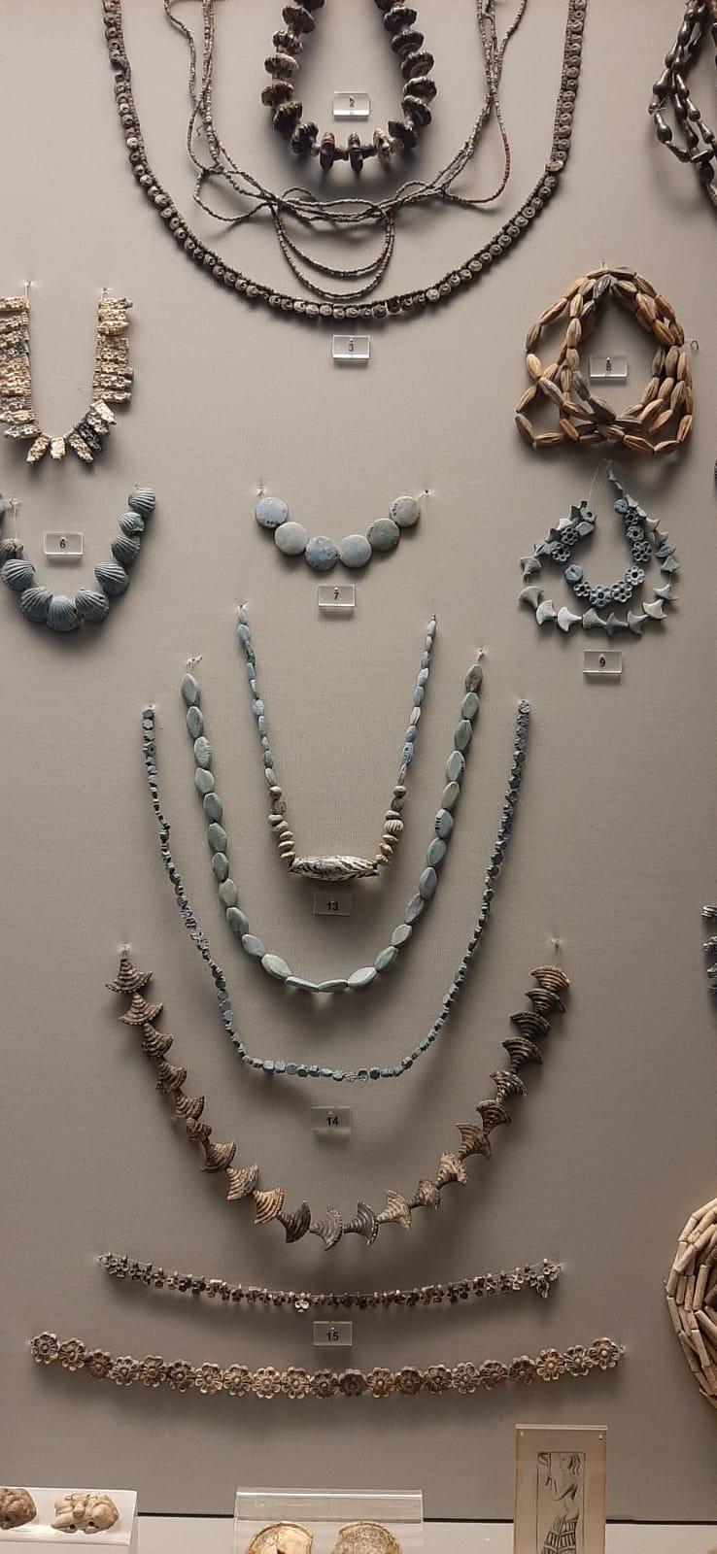
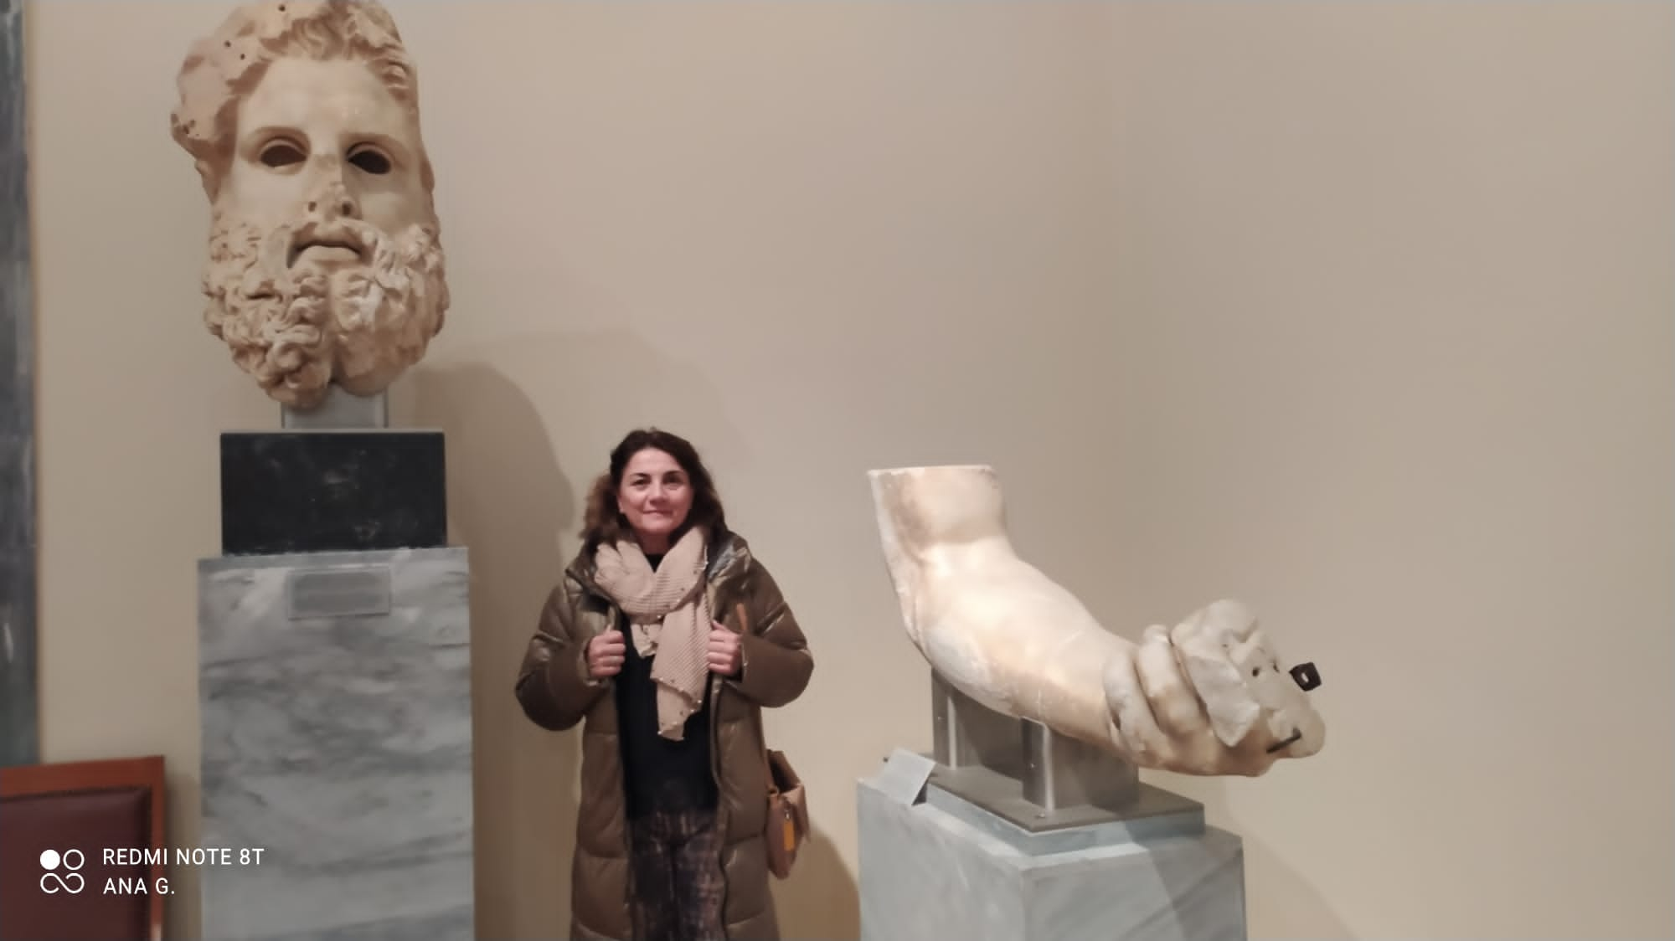

Slide 23
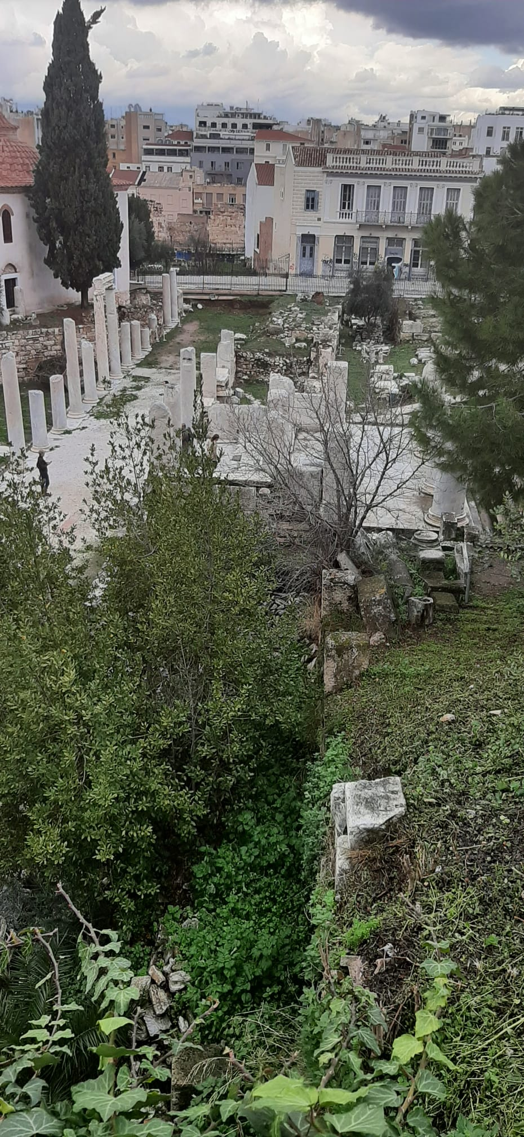

Slide 24
Change of Guard
Akropolis
Kerameikos
Aristotle School
Licabeto Hill
Zeus Temple
Agora
Monastiraki
Filopappou Hill
Syntagma
Plaka
……

Slide 25
Special cake with the project logo!

Slide 26
We came across Ana Remesal, PhD in Education Developmental Psychology at Barcelona University and had a conversation about the teaching-learning process in virtual and blended environments, we shared experiences in relation to our students behaviour in a technologically changing society, to software, evaluation techniques and the use or not of Catalan in the classroom.

Slide 27
Still learning onboard!
A good chance to browse an airport magazine, practise English or Greek

Slide 28
Ευχαριστώ τους συναδέλφους
The End
Don’t forget your personal belongings!

